Slide 1
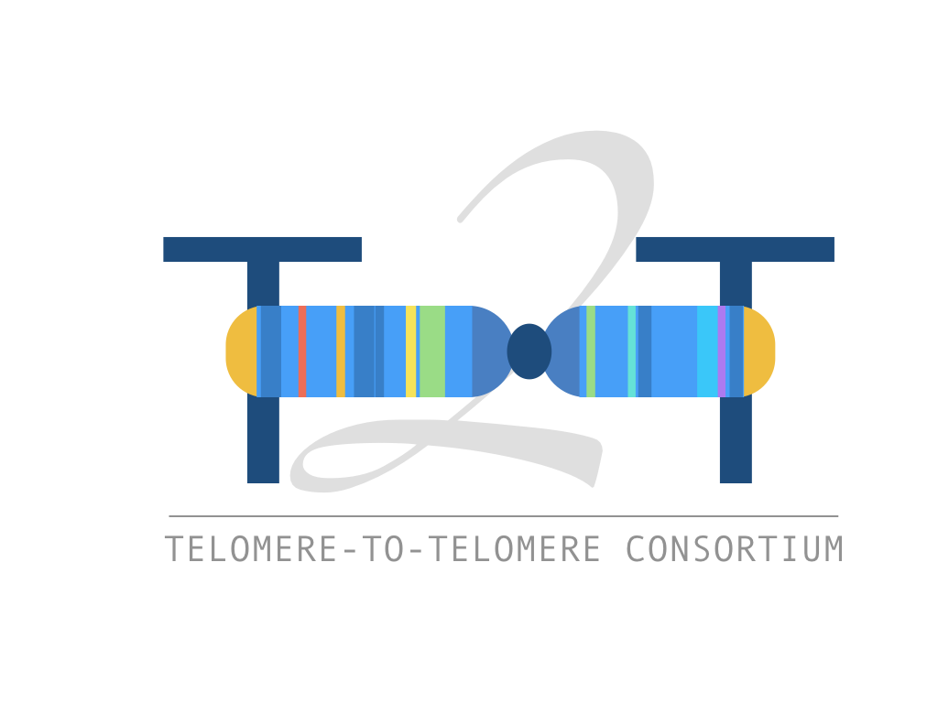
The T2T Genome and applications to variant calling
Dylan Taylor
Johns Hopkins University
November 18, 2022

Slide 2
Lesson Overview
Lecture Portion
What is a T2T Genome?
Benchmarking on a diverse dataset
Large-scale cloud analysis of short-read data
Improvements to alignment/variant calling
A T2T Y chromosome
Future directions
Live-coding Portion
Explore improvements to short-read alignment
Improvements in medically-relevant genes
Run variant calling on short-read alignments
Explore improvements to variant calling

Slide 3
Lesson Overview
Lecture Portion
What is a T2T Genome?
Benchmarking on a diverse dataset
Large-scale cloud analysis of short-read data
Improvements to alignment/variant calling
A T2T Y chromosome
Future directions
Live-coding Portion
Explore improvements to short-read alignment
Improvements in medically-relevant genes
Run variant calling on short-read alignments
Explore improvements to variant calling

Slide 4
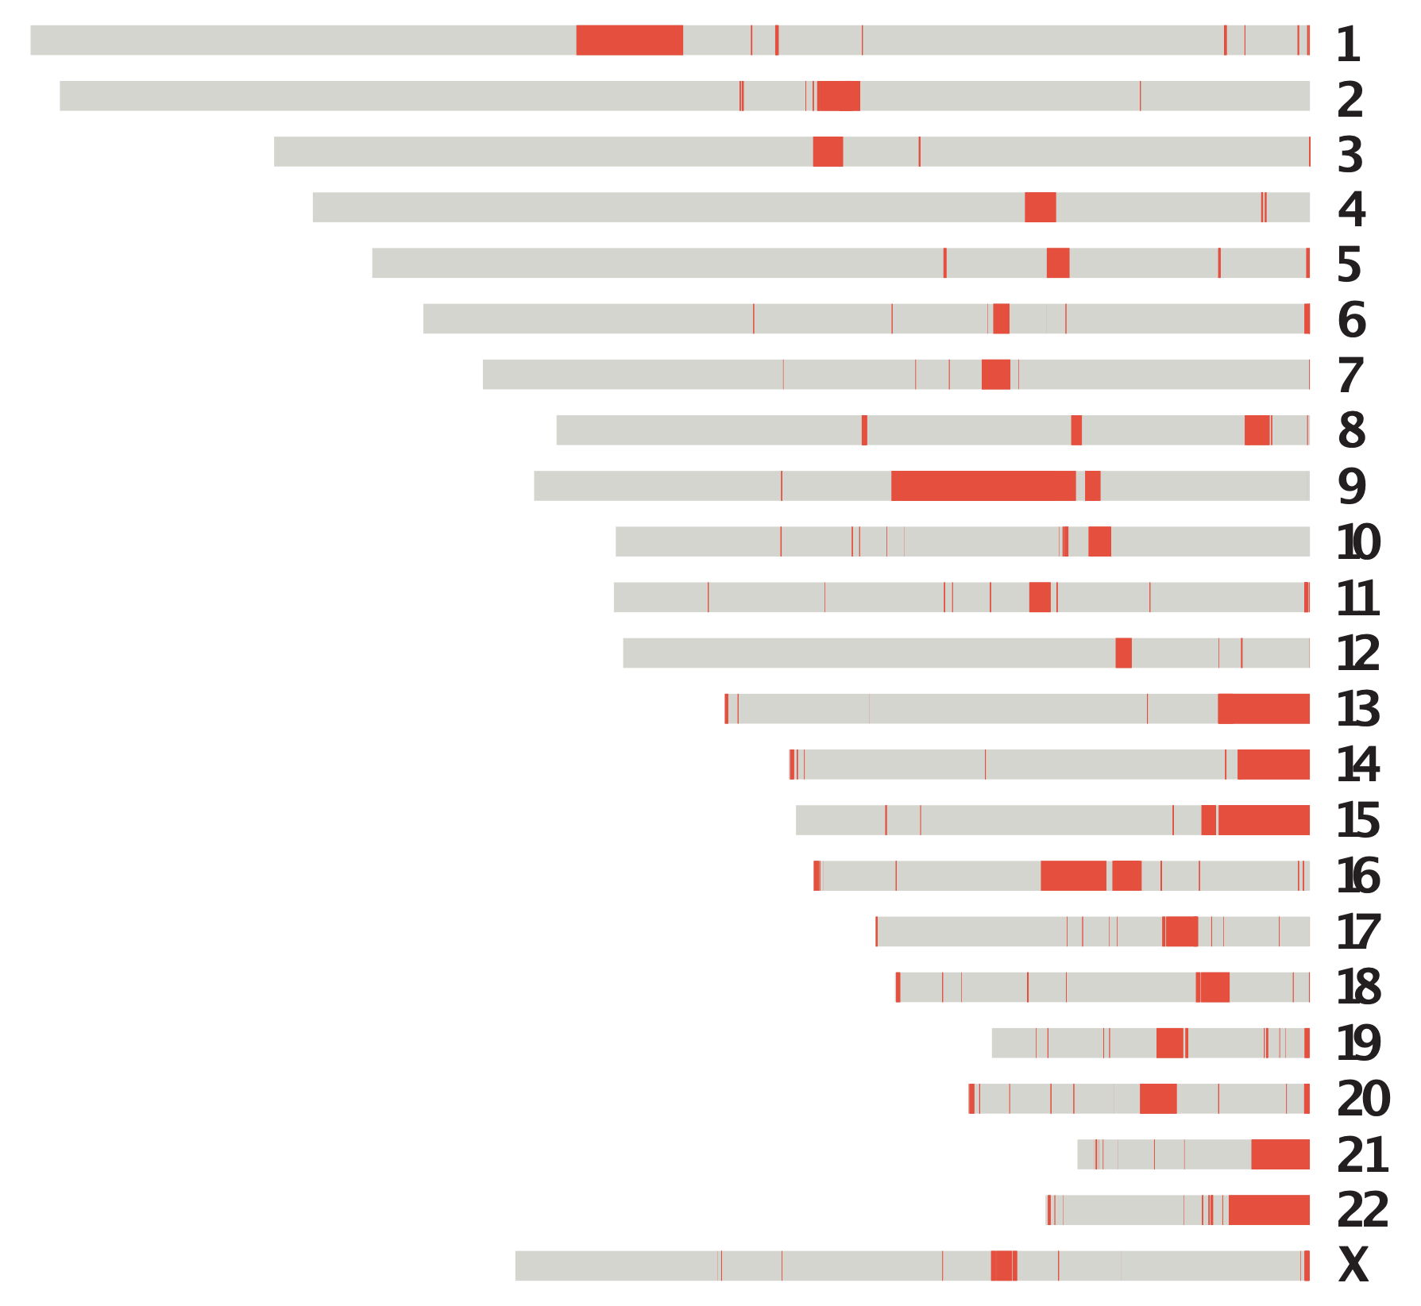
The “previous” human reference genome is incomplete
The human reference genome was first drafted in 2000, using short-read sequencing
GRCh38 has missing, incorrect, and/or artificial sequences
Centromeric regions
Segmental duplications
rDNA arrays
not in GRCh38
Nurk*, Koren*, Rhie*, Rautiainen*, et al., 2022, Science. The complete sequence of a human genome.
Notes:
a reference genome is an essential resource for any species; almost all sequencing data is compared to the reference
so the quality of the reference that you’re using is important
the first draft of the human reference genome was released in 2000 by the human genome project. GRCh38, the current human reference genome, is the descendant of that first draft and has undergone years of improvements, and it forms the basis of most genomic analysis today
because the human reference genome was assembled using short read sequencing, it had to deal with a lot of the limitations of short read genome assembly, which is that it’s unable to resolve some of the more complex regions of the genome
so despite decades of improvement after that initial assembly, GRCh38 still includes several missing, incorrect, or artificially represented sequences
What we want is a genome without any gaps, where each chromosome is complete from Telomere to telomere

Slide 5
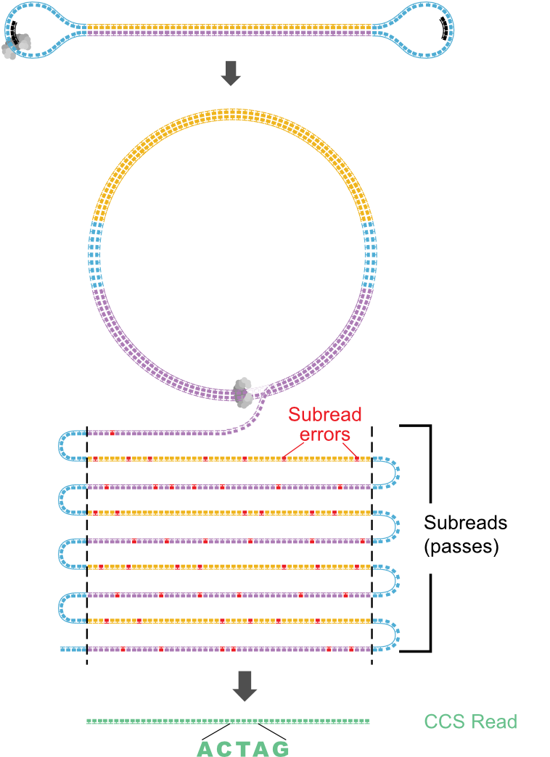
Assembling a complete Telomere-to-telomere genome
Begin with highly accurate PacBio HiFi reads
Wenger et al., 2019, Nat. Biotechnol. Accurate circular consensus long-read sequencing improves variant detection and assembly of a human genome.
Notes:
HiFi reads: 10-25kb (10 passes)

Slide 6
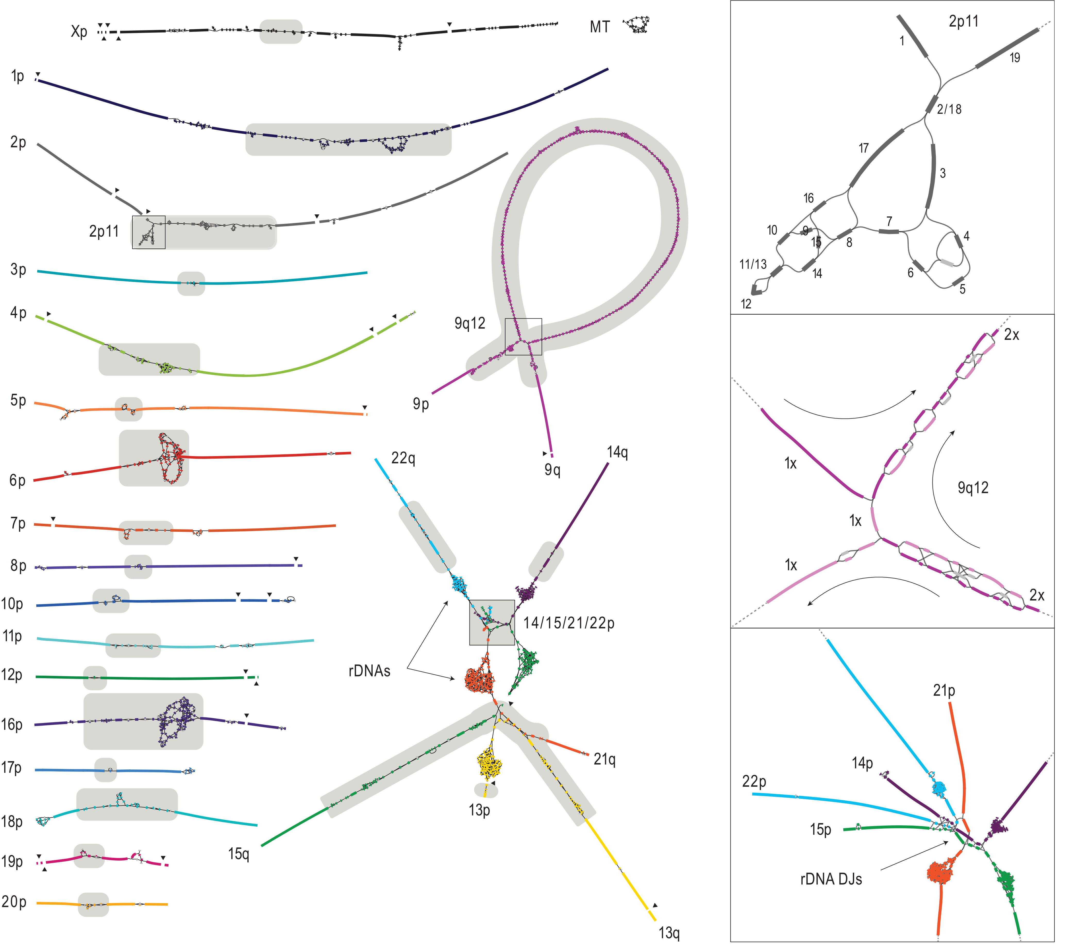
Assembling a complete Telomere-to-telomere genome
Begin with highly accurate PacBio HiFi reads
Using these, build high-resolution assembly string graph
Nurk*, Koren*, Rhie*, Rautiainen*, et al., 2022, Science. The complete sequence of a human genome.
Notes:
Five acrocentric chromosomes connected on short arms -> rDNA arrays

Slide 7
Assembling a complete Telomere-to-telomere genome
Begin with highly accurate PacBio HiFi reads
Using these, build high-resolution assembly string graph
Most chromosome assemblies are nearly linear
Nurk*, Koren*, Rhie*, Rautiainen*, et al., 2022, Science. The complete sequence of a human genome.
Notes:
Ultralong ONT: 100-300kb

Slide 8
Assembling a complete Telomere-to-telomere genome
Begin with highly accurate PacBio HiFi reads
Using these, build high-resolution assembly string graph
Most chromosome assemblies are nearly linear
Ultralong ONT reads + read coverage used to resolve loops in the string graph
Nurk*, Koren*, Rhie*, Rautiainen*, et al., 2022, Science. The complete sequence of a human genome.
Notes:
Ultralong ONT: 100-300kb

Slide 9
T2T-CHM13 is the complete sequence of a human genome
CHM13v1.1 genome size is 3.055 Gbp, with zero Ns
Every chromosome is telomere-to-telomere, quality estimated >Q70
~200 Mbp (3–6%) of new sequence vs. GRCh38, fixes thousands of errors
140 new putative protein-coding genes
not in GRCh38
Nurk*, Koren*, Rhie*, Rautiainen*, et al., 2022, Science. The complete sequence of a human genome.
Notes:
last year, the Telomere-to-Telomere consortium leveraged PacBio and nanopore long-read sequencing to create the T2T-CHM13 assembly, which is the first ever complete and gapless assembly of a human genome
The size of the CHM13 reference is 3.055 Gbp with no Ns
Every chromosome is assembled telomere to telomere with really high quality
and CHM13 also adds in about 200 Mbp of new sequence that was not in GRCh38, in addition to fixing many errors in the GRCh38 reference

Slide 10
T2T-CHM13 is the complete sequence of a human genome
CHM13v1.1 genome size is 3.055 Gbp, with zero Ns
Every chromosome is telomere-to-telomere, quality estimated >Q70
~200 Mbp (3–6%) of new sequence vs. GRCh38, fixes thousands of errors
140 new putative protein-coding genes
Most accurate assembly ever produced
not in GRCh38
Nurk*, Koren*, Rhie*, Rautiainen*, et al., 2022, Science. The complete sequence of a human genome.
Notes:
last year, the Telomere-to-Telomere consortium leveraged PacBio and nanopore long-read sequencing to create the T2T-CHM13 assembly, which is the first ever complete and gapless assembly of a human genome
The size of the CHM13 reference is 3.055 Gbp with no Ns
Every chromosome is assembled telomere to telomere with really high quality
and CHM13 also adds in about 200 Mbp of new sequence that was not in GRCh38, in addition to fixing many errors in the GRCh38 reference

Slide 11
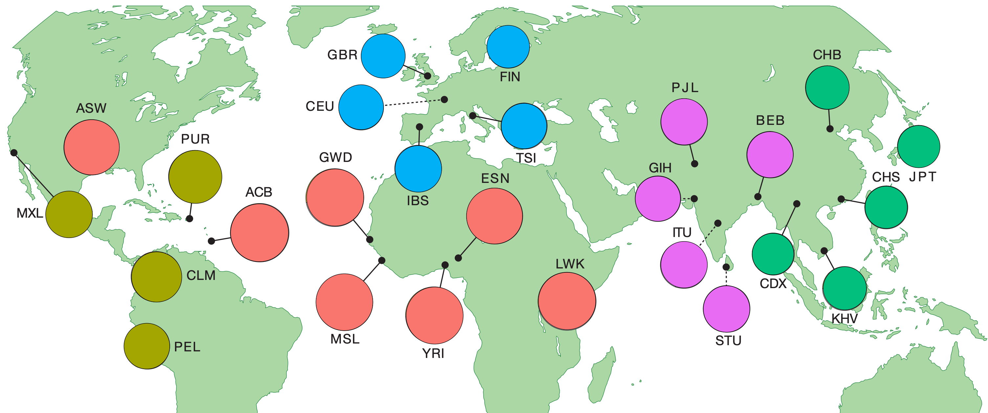
Analyzing diverse, short-read data with T2T-CHM13
1000 Genomes Project (1KGP): 3202 samples from 5 continental groups
30x sequencing by the New York Genome Center
Byrska-Bishop et al., 2022, Cell. High coverage whole-genome sequencing of the expanded 1000 Genomes Project cohort including 602 trios.
Notes:
next, we looked into how using the CHM13 assembly can affect genetic analyses. We started off by looking at analyzing short-read data with CHM13
to test this, we used high-coverage sequencing data from the 1000 Genomes project, which is a diverse dataset of over 3000 samples from 5 continental populations. Those continental groups are the colors on the map here. These samples were recently resequenced to 30x coverage by the New York Genome Center, so it provides a huge, diverse, and high-quality short-read dataset to benchmark CHM13 on.

Slide 12
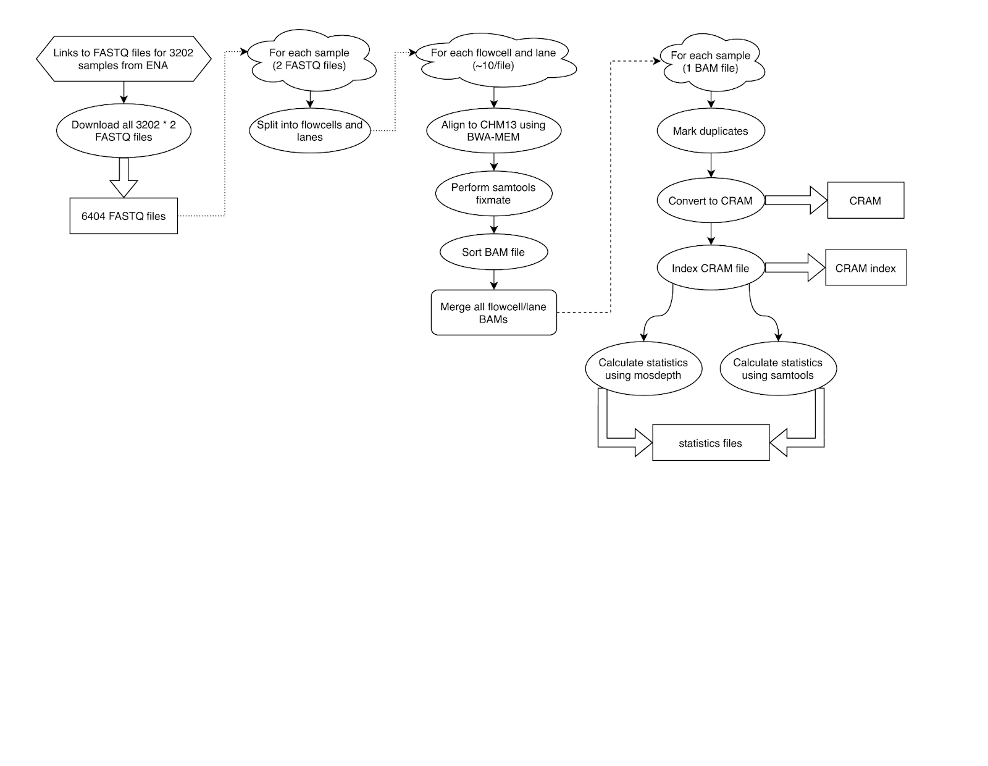
Population-scale short-read alignment and variant calling
Sergey Aganezov
Samantha Zarate
Notes:
we created an alignment and variant calling workflow that matches the one used by the 1000 Genomes Project on GRCh38. That way, since the workflow is identical, it allows us to directly compare the effects of the GRCh38 and CHM13 reference genomes
Because the 1000 Genomes dataset is so large, where just the raw sequencing reads take up 96 Tb of data, we ended up doing all of this computation on AnVIL, which is a cloud analysis platform that allowed us to finish all of the alignment and variant calling in just a few weeks

Slide 13
Population-scale short-read alignment and variant calling
3202 samples x 30Gb = 96Tb input data!
Sergey Aganezov
Samantha Zarate
Notes:
we created an alignment and variant calling workflow that matches the one used by the 1000 Genomes Project on GRCh38. That way, since the workflow is identical, it allows us to directly compare the effects of the GRCh38 and CHM13 reference genomes
Because the 1000 Genomes dataset is so large, where just the raw sequencing reads take up 96 Tb of data, we ended up doing all of this computation on AnVIL, which is a cloud analysis platform that allowed us to finish all of the alignment and variant calling in just a few weeks

Slide 14
Population-scale short-read alignment and variant calling
AnVIL
3202 samples x 30Gb = 96Tb input data!
Sergey Aganezov
Samantha Zarate
Notes:
we created an alignment and variant calling workflow that matches the one used by the 1000 Genomes Project on GRCh38. That way, since the workflow is identical, it allows us to directly compare the effects of the GRCh38 and CHM13 reference genomes
Because the 1000 Genomes dataset is so large, where just the raw sequencing reads take up 96 Tb of data, we ended up doing all of this computation on AnVIL, which is a cloud analysis platform that allowed us to finish all of the alignment and variant calling in just a few weeks

Slide 15
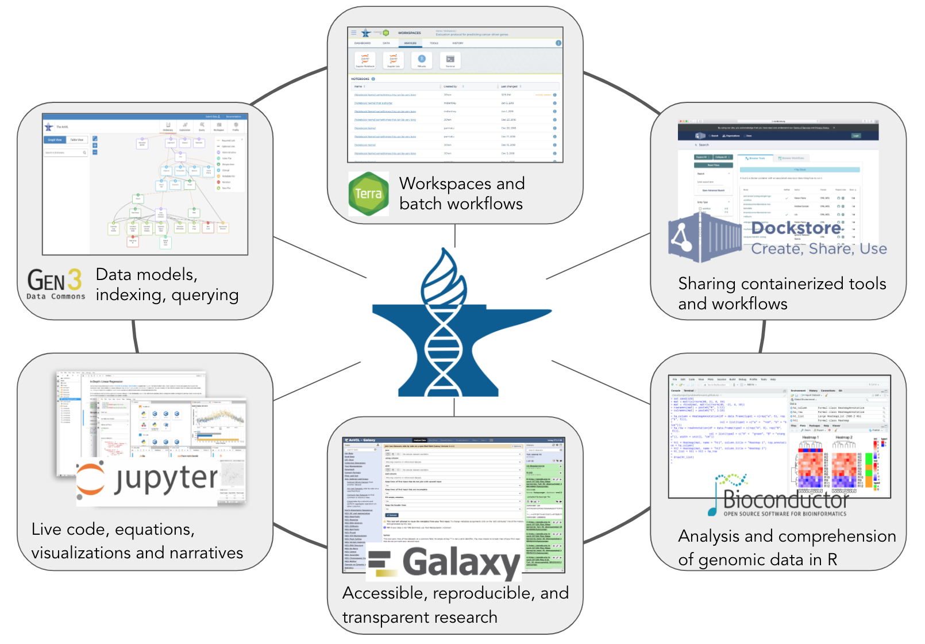
anvilproject.org
Schatz et al., 2022, Cell Genomics. Inverting the model of genomics data sharing with the NHGRI Genomic Data Science Analysis, Visualization, and Informatics Lab-space.
Notes:
AnVIL is a cloud computing platform developed to facilitate reproducible science AND large scale analyses. It integrates a number of services: terra, jupyter, docker, bioconductor

Slide 16
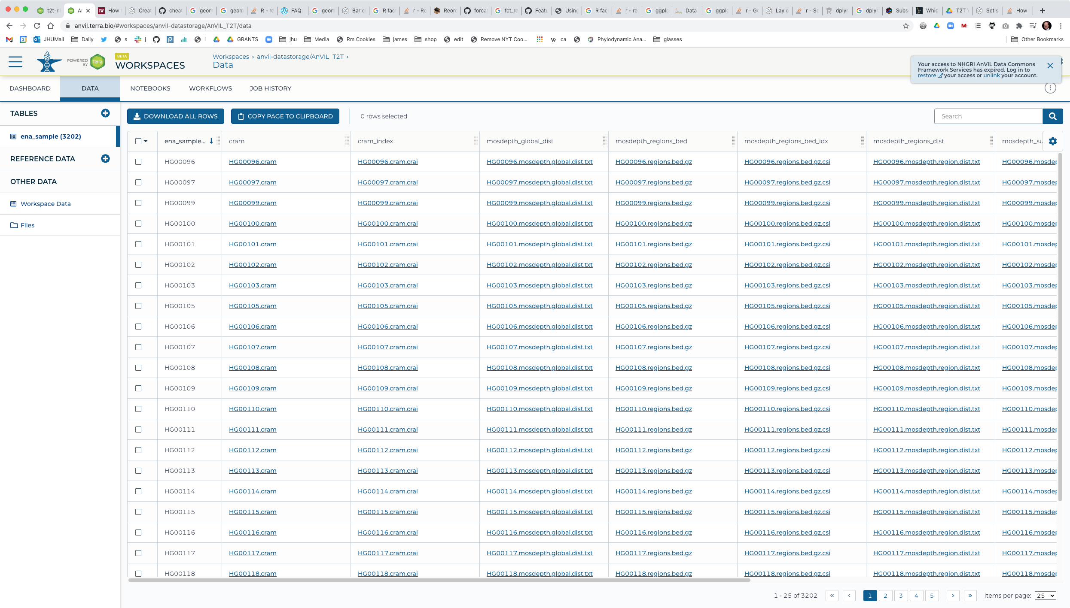
AnVIL: Data Table
Notes:
How we manage data – this is publicly available

Slide 17
Population-scale short-read alignment and variant calling
AnVIL
3202 samples x 30Gb = 96Tb input data!
Sergey Aganezov
Samantha Zarate
Notes:
we created an alignment and variant calling workflow that matches the one used by the 1000 Genomes Project on GRCh38. That way, since the workflow is identical, it allows us to directly compare the effects of the GRCh38 and CHM13 reference genomes
Because the 1000 Genomes dataset is so large, where just the raw sequencing reads take up 96 Tb of data, we ended up doing all of this computation on AnVIL, which is a cloud analysis platform that allowed us to finish all of the alignment and variant calling in just a few weeks

Slide 18
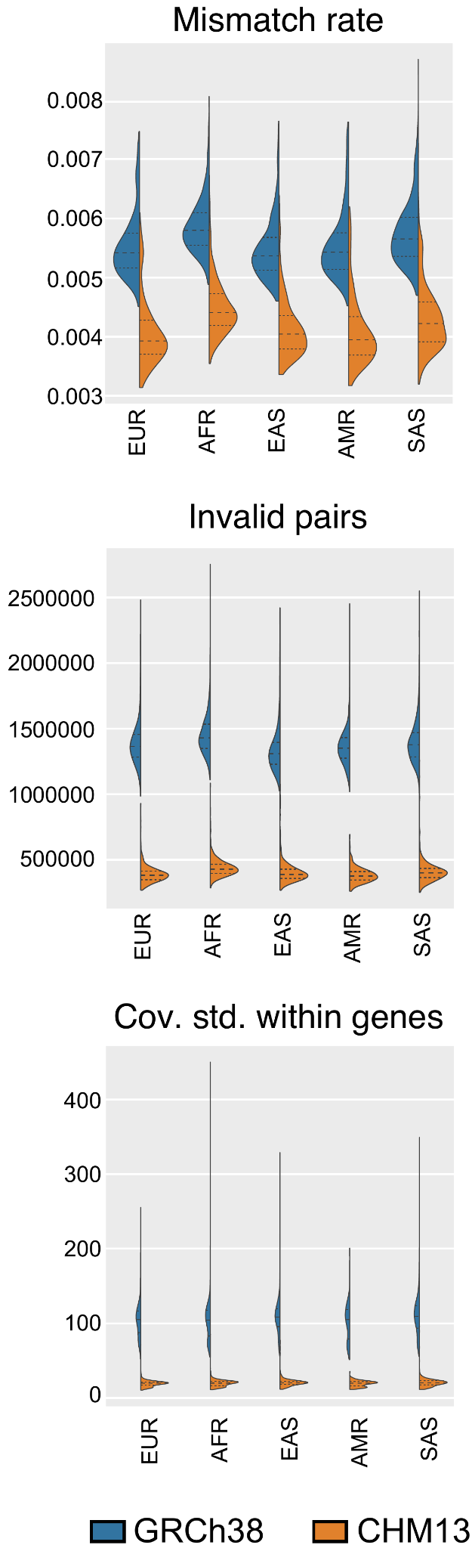
T2T-CHM13 improves short-read alignment
Sergey Aganezov
Notes:
Decreased mismatch rate > reads are more similar to CHM13 than GRCh38
similarly, we also observe improvements in other alignment metrics like a reduction in the total number of invalid paired reads
we also see a decrease in the standard deviation of coverage within genes, which indicates that on CHM13 there are fewer genes that have very low or very high sequencing coverage, likely because CHM13 fixes duplicated sequences that are incorrectly represented in GRCh38

Slide 19
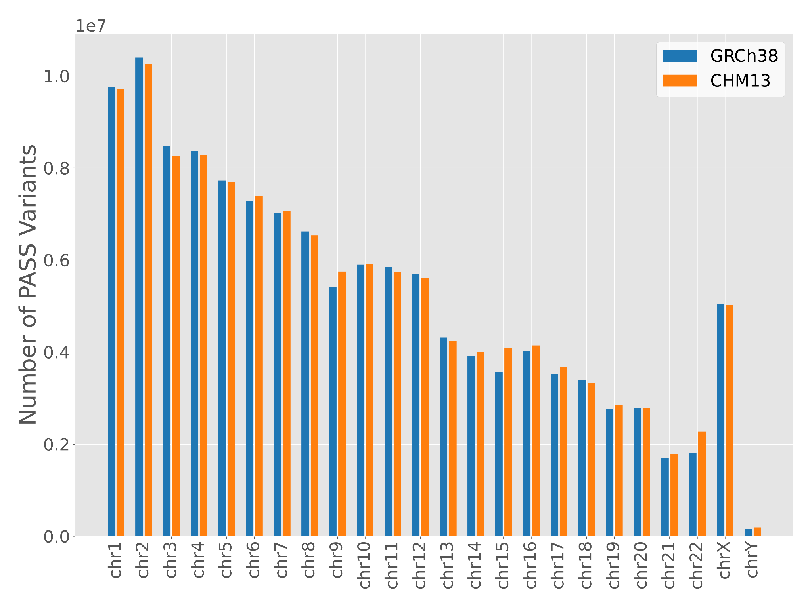
T2T-CHM13 allows discovery of more variants
 | GRCh38 | CHM13
# of PASS variants | 125,484,020 | 126,591,489
Notes:
We see more variants overall in CHM13, presumably partially because of the added sequence

Slide 20
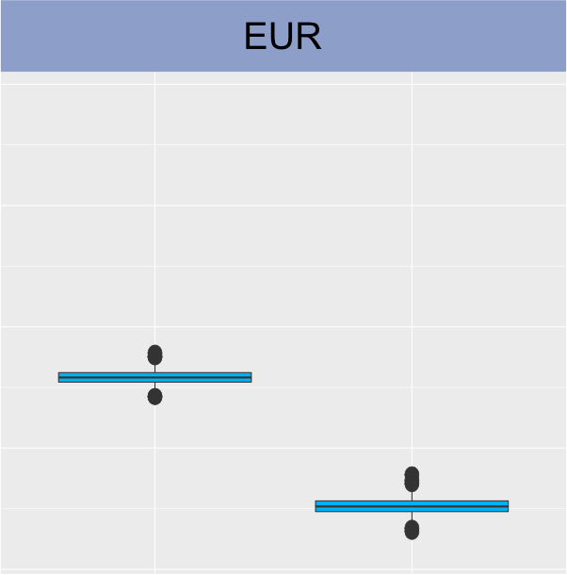
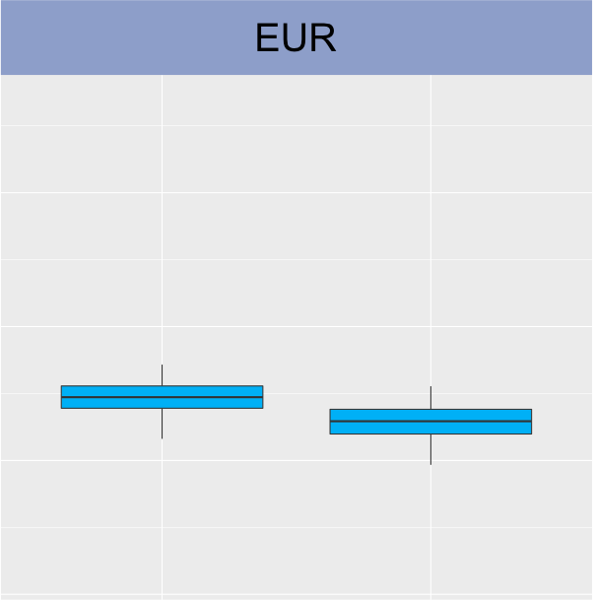
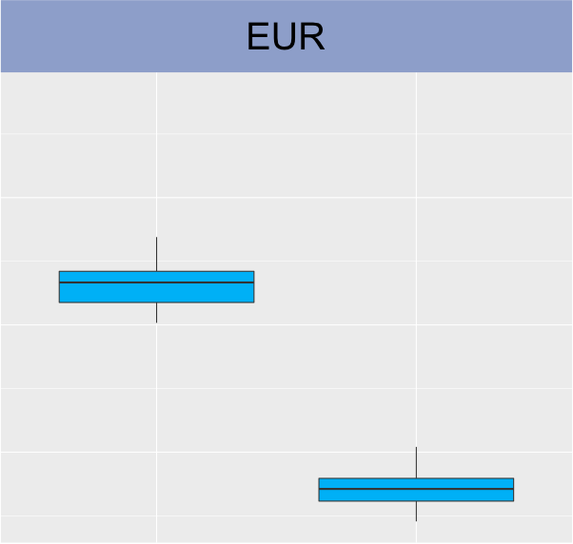
T2T-CHM13 reduces per-sample variant counts
Genome-wide
Heterozygous
Homozygous
Number of variants/sample
GRCh38
CHM13
GRCh38
CHM13
GRCh38
CHM13
Notes:
Number of variants per person decreased due to a reduction in the number of spurious variants (esp in complex regions).
Greater shift in homozygous vs heterozygous -- improvements in rare alleles, consensus errors, structural errors in CHM13 vs GRCh38

Slide 21
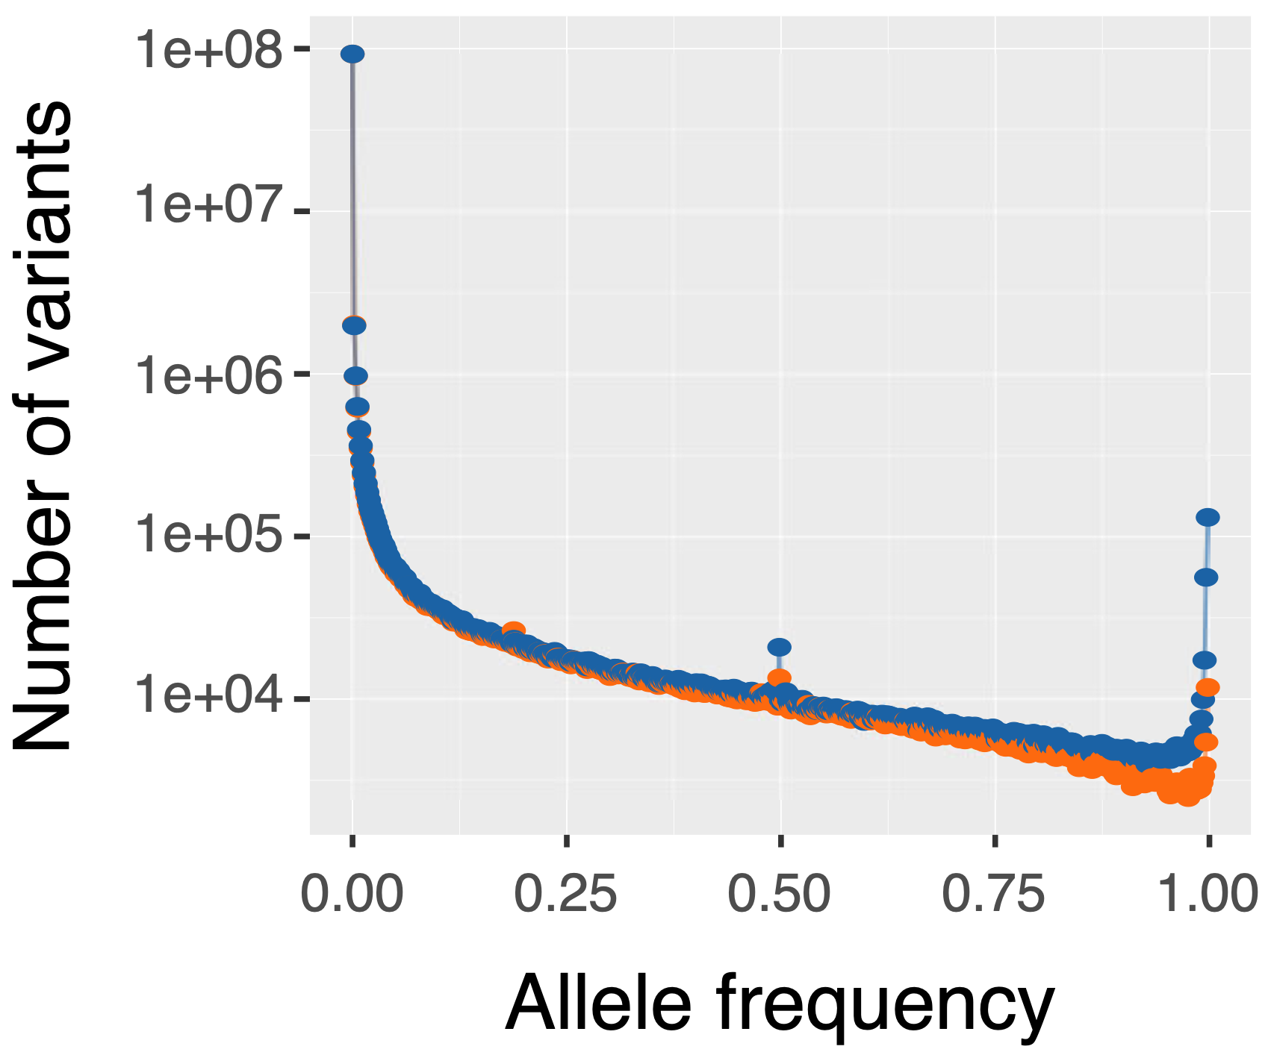
T2T-CHM13 improves short-read variant calling
Excess of fixed variants when using GRCh38 is due to reference errors
EUR
Samantha Zarate
Notes:
so that was short-read alignment - how about variant calling
this is the allele frequency spectrum we see for short-read variants, which looks more or less normal, but I’m going to point out two parts of this plot

Slide 22
T2T-CHM13 improves short-read variant calling
Excess of fixed variants when using GRCh38 is due to reference errors
EUR
GRCh38
…ATGGCAATATG…
Samples
…ATGGTAATATG…
…ATGGTAATATG…
AF = 1.0
…ATGGTAATATG…
…ATGGTAATATG…
…ATGGTAATATG…
…ATGGTAATATG…
Samantha Zarate
Notes:
the first is this section on the right, which shows variants with an allele frequency of 1, meaning that everyone in our dataset carries this variant, but not the reference genome
you can see that that blue line is above the orange, meaning that we observe way more of these fixed variants in GRCh38 than in CHM13, and we actually attribute this to errors in the reference genome. If GRCh38 has an error, most likely nobody else you sequence will have that same error, and it gives the appearance of a variant that everyone carries
so in CHM13, without these errors, we see a lower number of these false fixed variants because we have fewer errors
the overall downward shift for CHM13 is due to the ancestry differences between the references. “Because GRCh38 was predominantly African American ancestry, it was enriched for rare variation, which manifests as common variation in a sample of other genomes.”

Slide 23
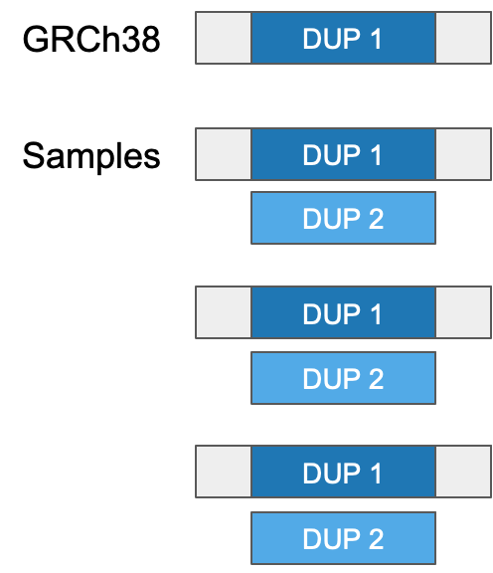
T2T-CHM13 improves short-read variant calling
Fewer false heterozygous variants from GRCh38 collapsed duplications
EUR
AF = 0.5
Samantha Zarate
Notes:
the reason why this peak occurs is that there are collapsed duplications throughout GRCh38, where you have two copies of a sequence that are almost identical except for one or two bases
when you align sequencing reads to this collapsed duplication, all the reads align to this one copy in the reference. So at sites where the two copies are different, you get variants that appear to be heterozygous in every single sample, when in reality they just represent the two different copies
it’s kind of hard to see because the y axis is log scaled, but when aligning to CHM13, which correctly separates out these duplications, we observe a decrease in these false heterozygous variants

Slide 24
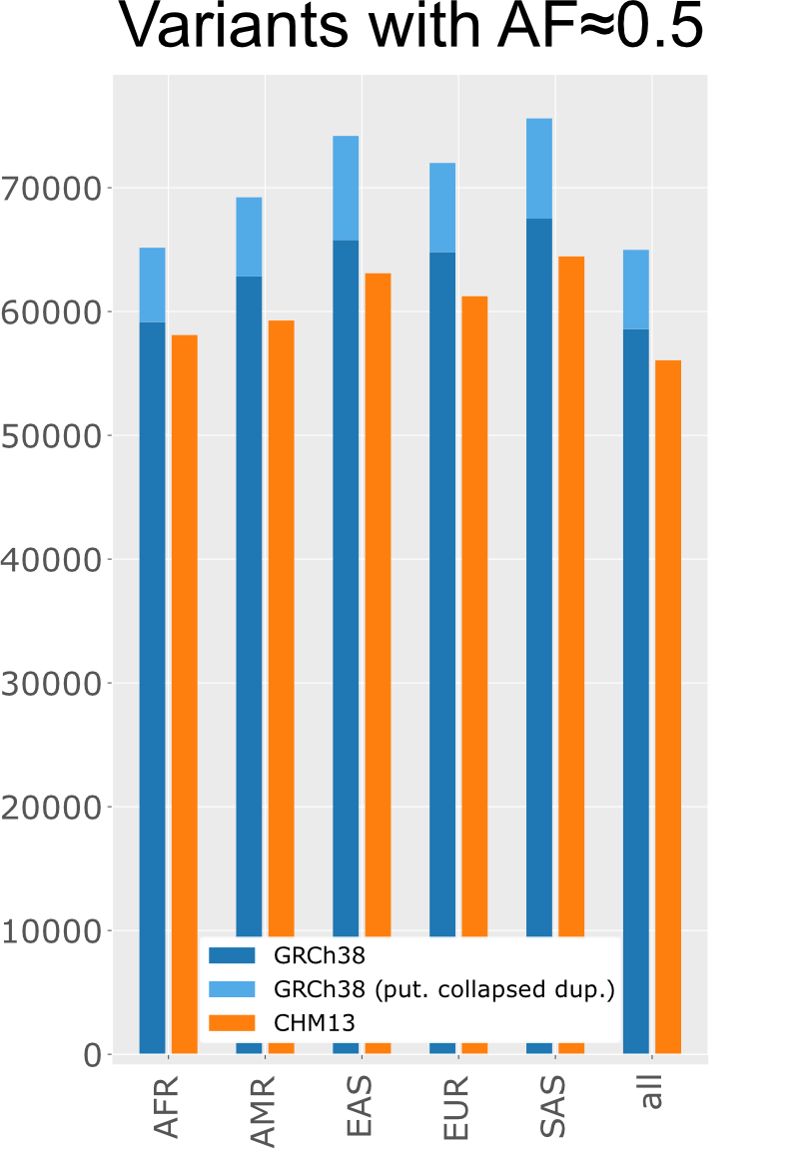
T2T-CHM13 improves short-read variant calling
Fewer false heterozygous variants from GRCh38 collapsed duplications
EUR
AF = 0.5
Samantha Zarate
Notes:
the reason why this peak occurs is that there are collapsed duplications throughout GRCh38, where you have two copies of a sequence that are almost identical except for one or two bases
when you align sequencing reads to this collapsed duplication, all the reads align to this one copy in the reference. So at sites where the two copies are different, you get variants that appear to be heterozygous in every single sample, when in reality they just represent the two different copies
it’s kind of hard to see because the y axis is log scaled, but when aligning to CHM13, which correctly separates out these duplications, we observe a decrease in these false heterozygous variants

Slide 25
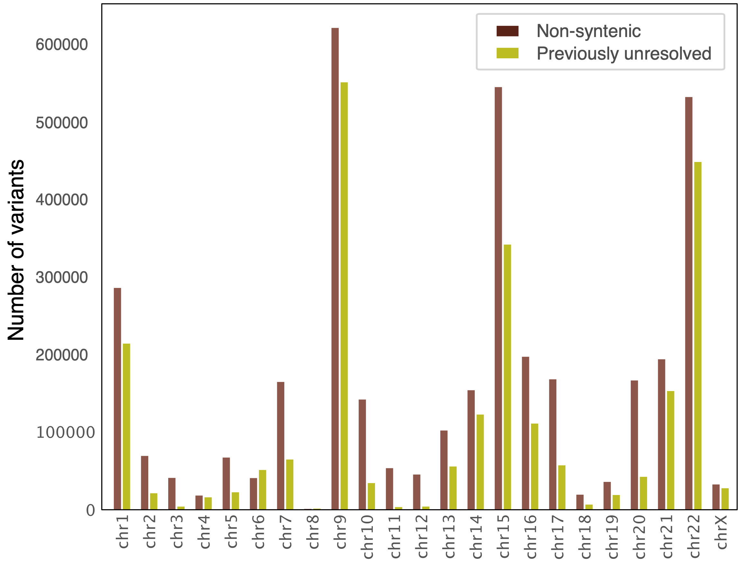
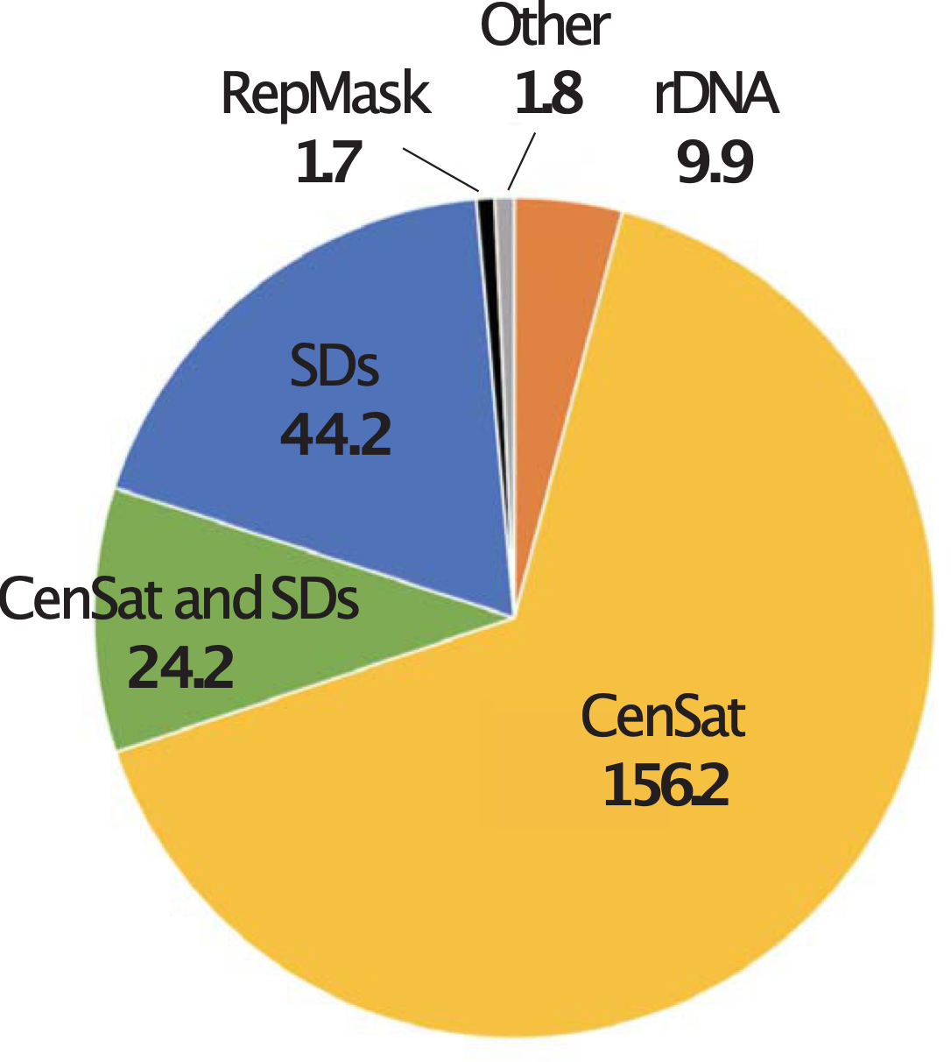
“Novel” variants revealed by T2T-CHM13
Samantha Zarate
Notes:
in addition to improving short-read and long-read variant calling, we also know that CHM13 adds about 200 Mb of sequence that isn’t in the GRCh38 reference genome
if you look at the breakdown of where these novel sequences are in the genome, most of them are centromere proximal, or in segmentally duplicated sequences
and within these novel sequences, we also called tens of thousands of variants on each chromosome
so these aren’t just junk regions that we don’t care about, there are lots of variants in these regions that could be biologically interesting

Slide 26
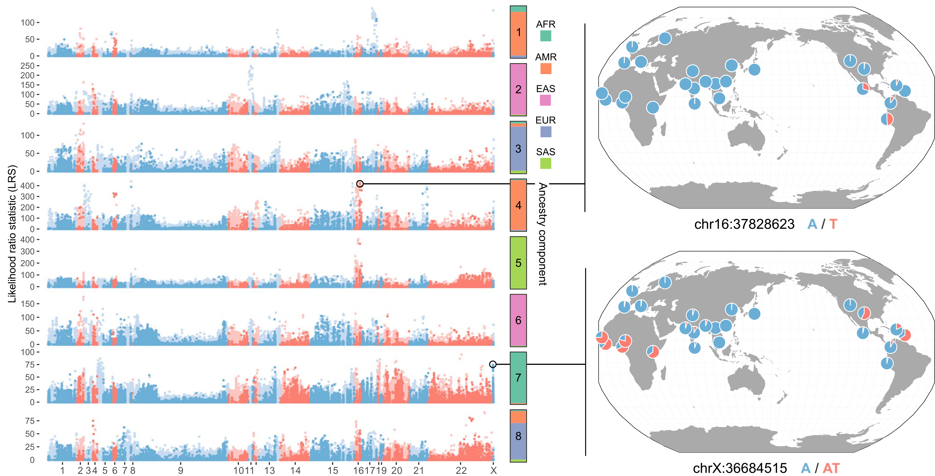

Extreme AF differentiation of novel variants
Stephanie Yan
Notes:
in addition to improving short-read and long-read variant calling, we also know that CHM13 adds about 200 Mb of sequence that isn’t in the GRCh38 reference genome
if you look at the breakdown of where these novel sequences are in the genome, most of them are centromere proximal, or in segmentally duplicated sequences
and within these novel sequences, we also called tens of thousands of variants on each chromosome
so these aren’t just junk regions that we don’t care about, there are lots of variants in these regions that could be biologically interesting

Slide 27
Long-read alignment and variant calling with T2T-CHM13
17 diverse samples from the Human Pangenome Reference Consortium and Genome in a Bottle
PacBio HiFi data + 14 samples with ONT data
Melanie Kirsche
Sergey Aganezov
Notes:
after benchmarking short reads, we moved on to comparing long-read alignment and variant calling
to do this, we used PacBio and nanopore data from 17 diverse samples, sequenced by the Human Pangenome Reference Consortium and Genome in a Bottle

Slide 28
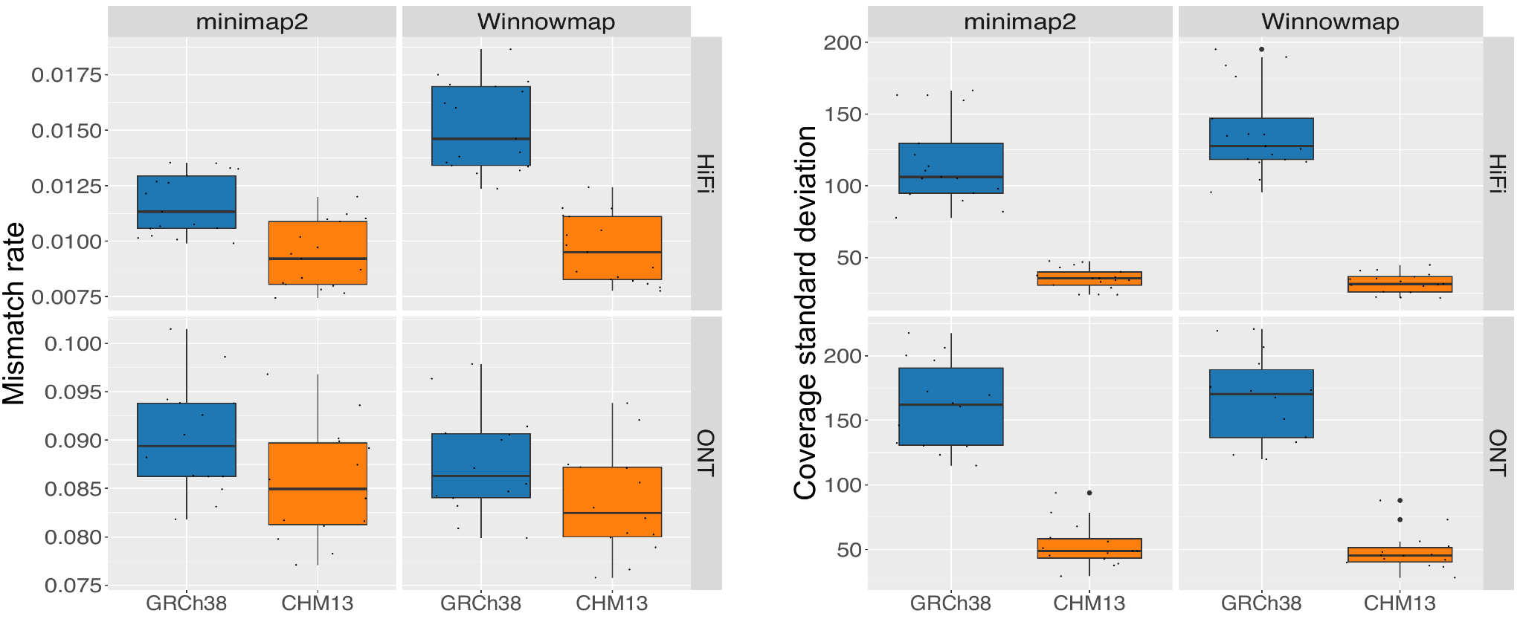
T2T-CHM13 improves alignment for long reads
Melanie Kirsche
Sergey Aganezov
Notes:
we compared long-read alignment to GRCh38 and CHM13 using two different aligners, minimap2 and winnowmap
I’m showing just one of the metrics we compared here, which is read mismatch rate, and you can see that when using pacbio HiFi data for both of these aligners, we observe a lower rate of mismatch when aligning to CHM13

Slide 29
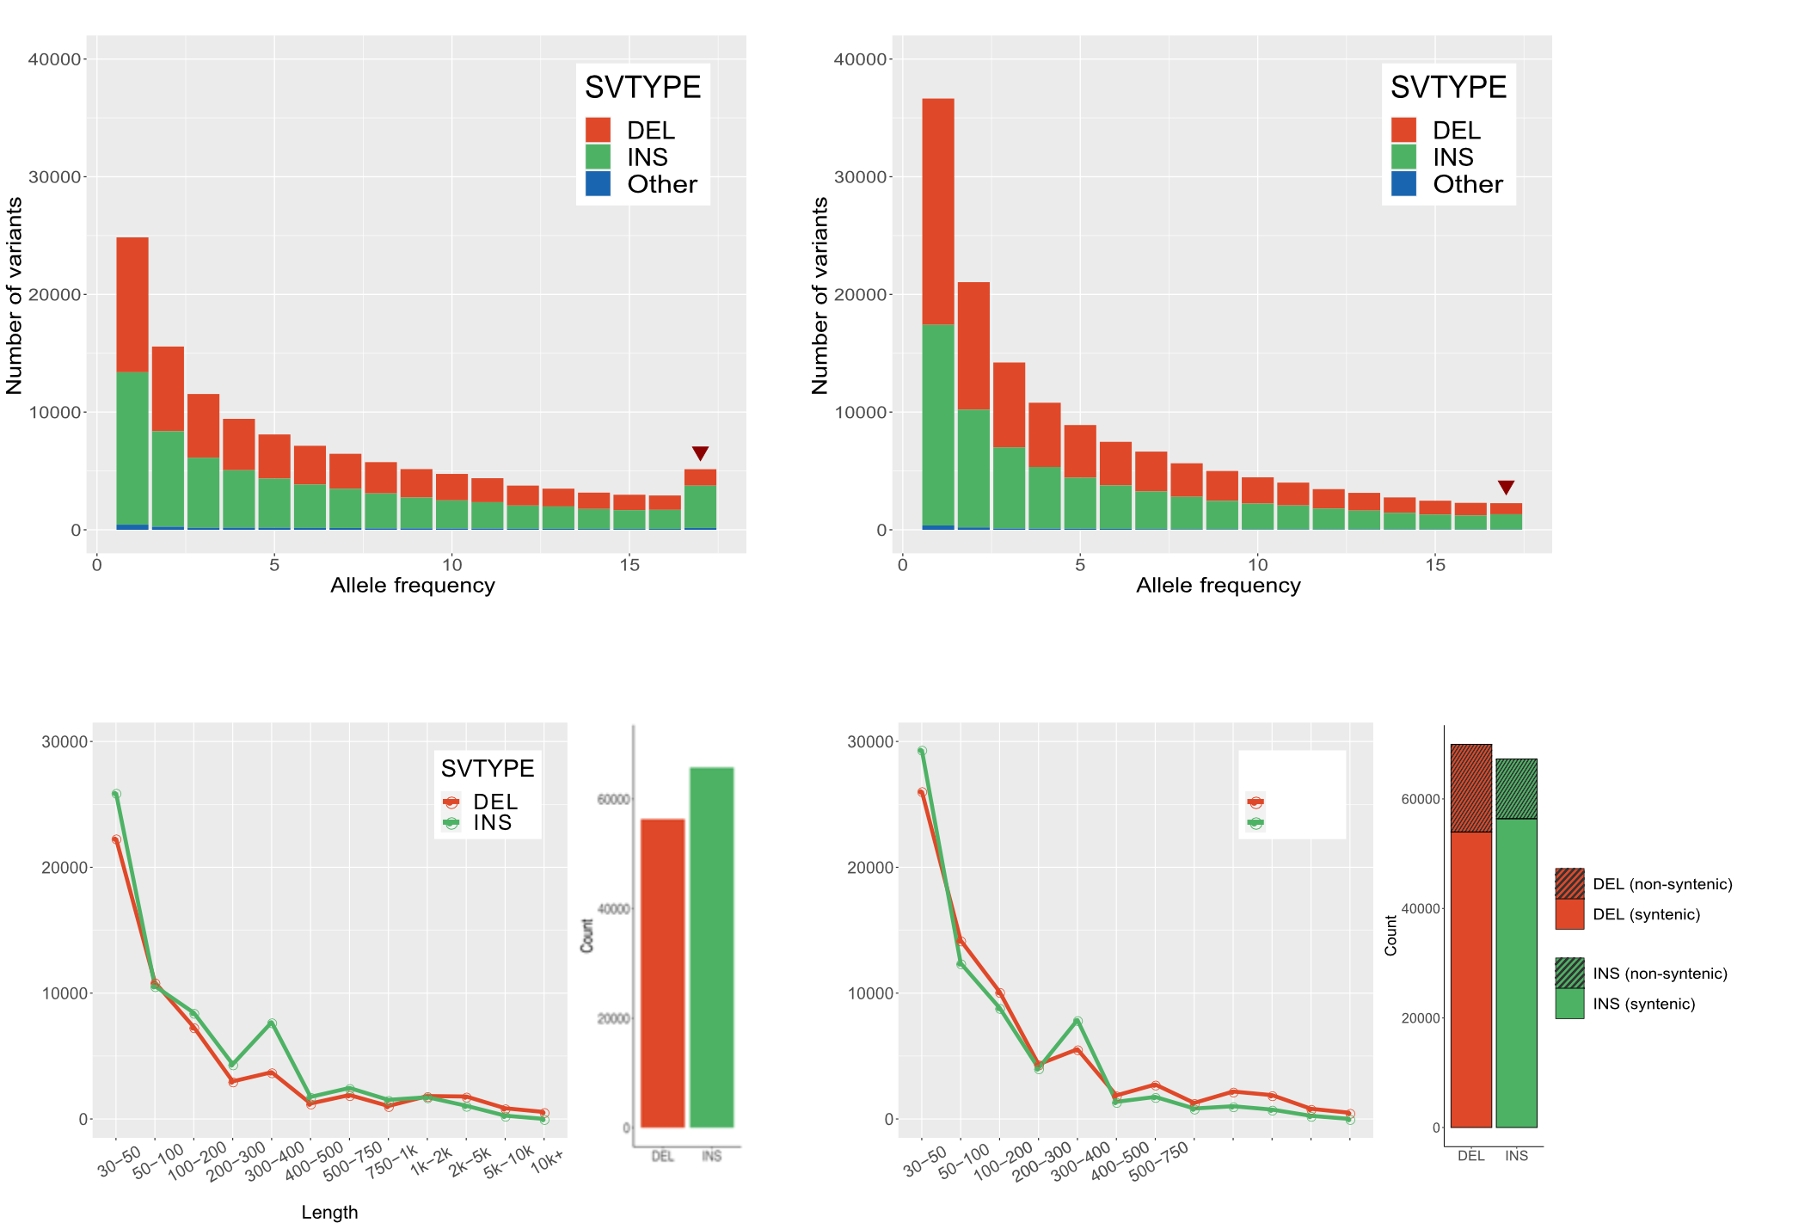
T2T-CHM13 improves SV-calling with long reads
Melanie Kirsche
Sergey Aganezov
Notes:
we compared long-read alignment to GRCh38 and CHM13 using two different aligners, minimap2 and winnowmap
I’m showing just one of the metrics we compared here, which is read mismatch rate, and you can see that when using pacbio HiFi data for both of these aligners, we observe a lower rate of mismatch when aligning to CHM13

Slide 30
T2T-CHM13 improves SV-calling with long reads
Melanie Kirsche
Sergey Aganezov
Notes:
Fewer AF=1 SVs on CHM13
Additionally, CHM13 has more even del/ins ratio. GRCh38 has excess of insertions due to missing or incomplete/collapsed regions

Slide 31
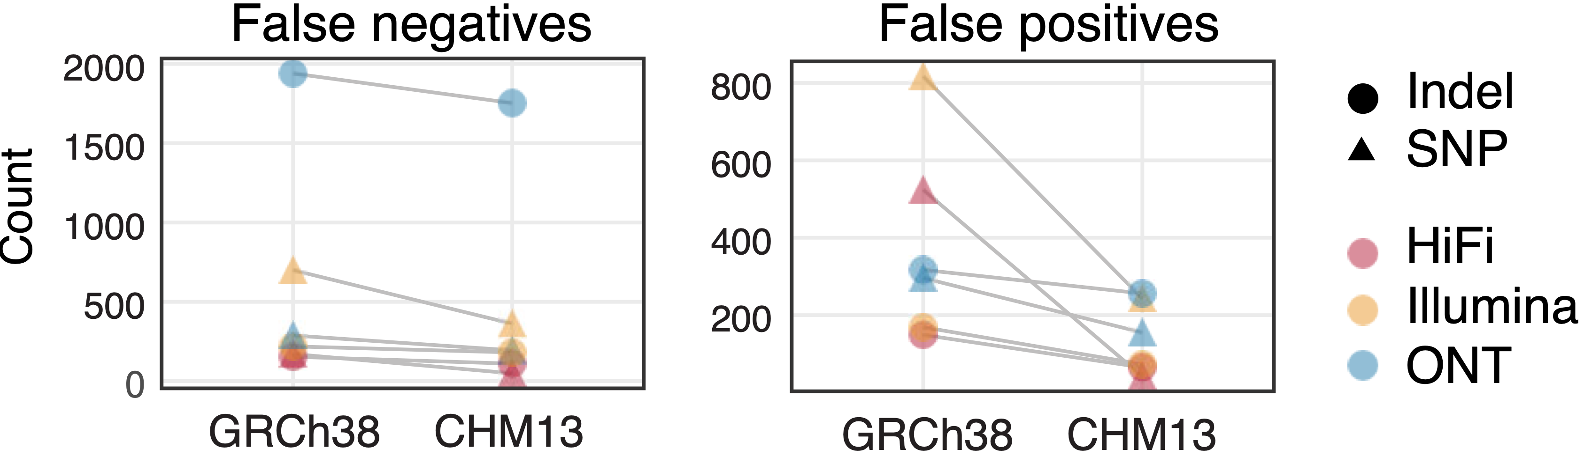




T2T-CHM13 improves clinical genomics variant calling
273 challenging, medically relevant genes
Benchmarked with sequencing data from HG002
Daniela Soto
Megan Dennis
Justin Zook
Fritz Sedlazeck
Danny Miller
Notes:
the last thing we did is that we benchmarked the performance of GrCh38 and CHM13 using a set of 273 challenging medically relevant genes, defined by the Genome in a Bottle consortium
we found that for this set of genes, we see a reduction in both false negatives and false positives, across all variant types and sequencing types
this kind of underscores the improvement we can see when using CHM13, especially in challenging regions of the genome

Slide 32
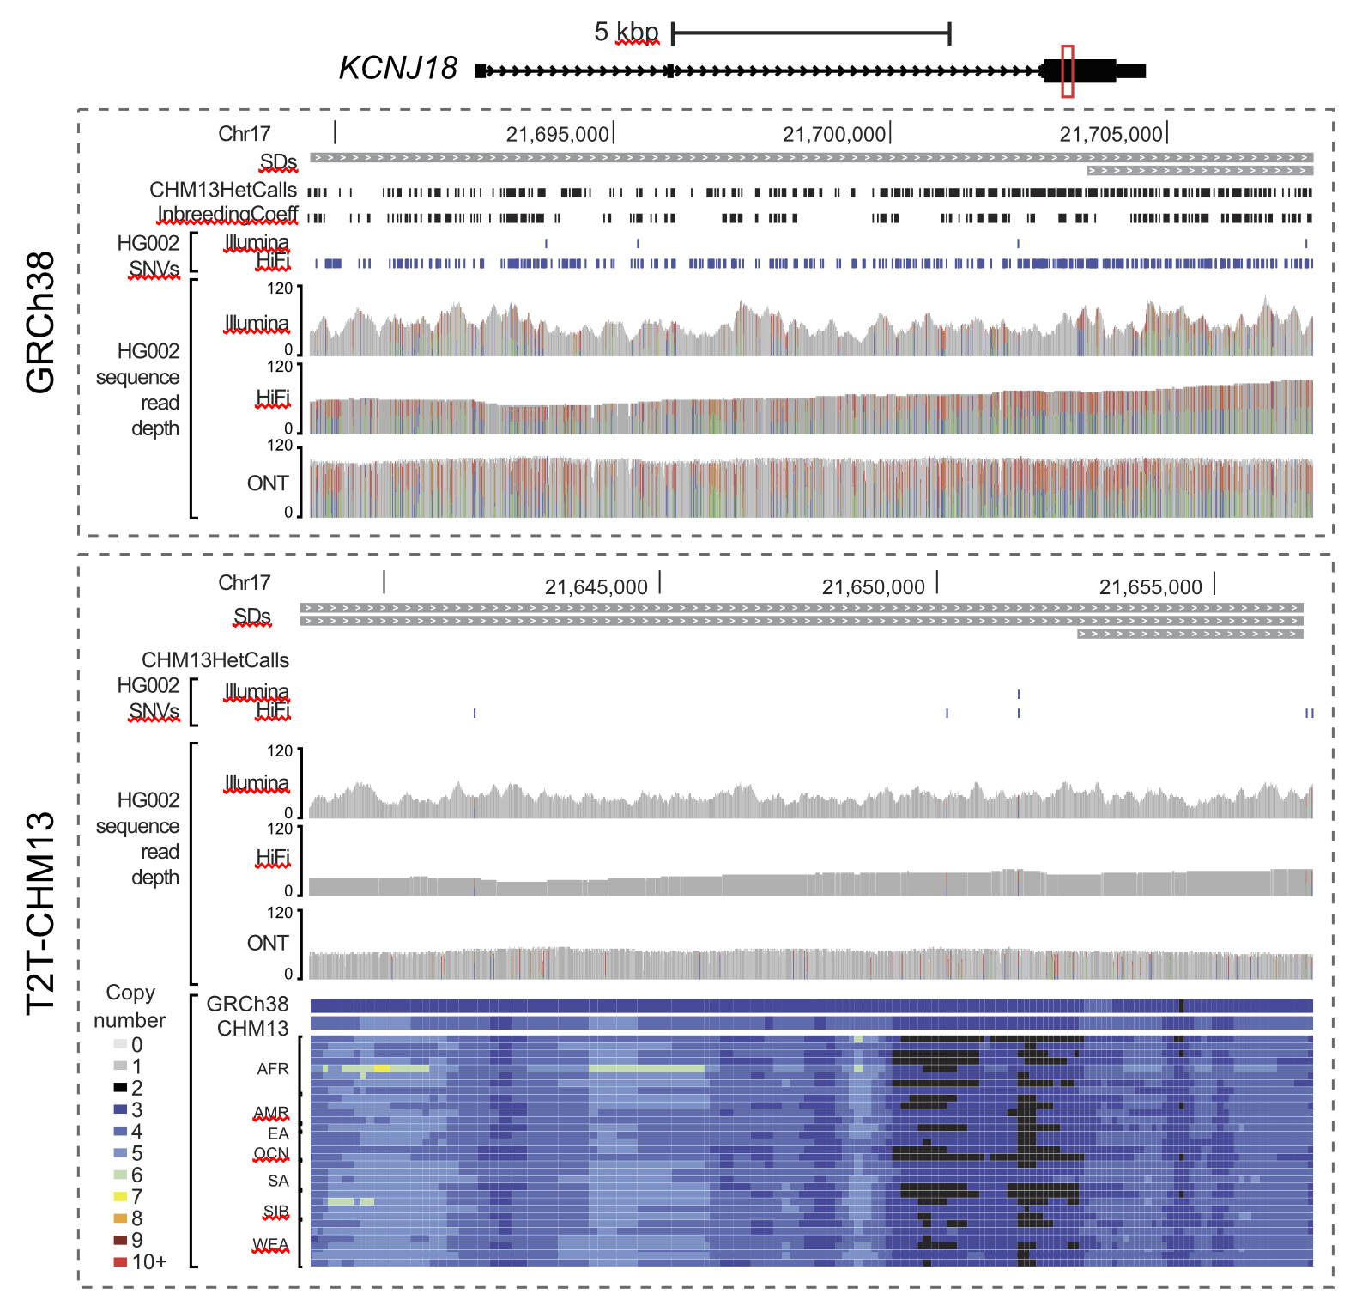
T2T-CHM13 improves clinical genomics variant calling
Daniela Soto
Megan Dennis
Justin Zook
Fritz Sedlazeck
Danny Miller
Notes:
KCNJ18: periodic muscle paralysis, including nine "pathogenic" or "likely pathogenic" ClinVar variants Inside a collapsed duplication. Lots of variants, high coverage.

Slide 33
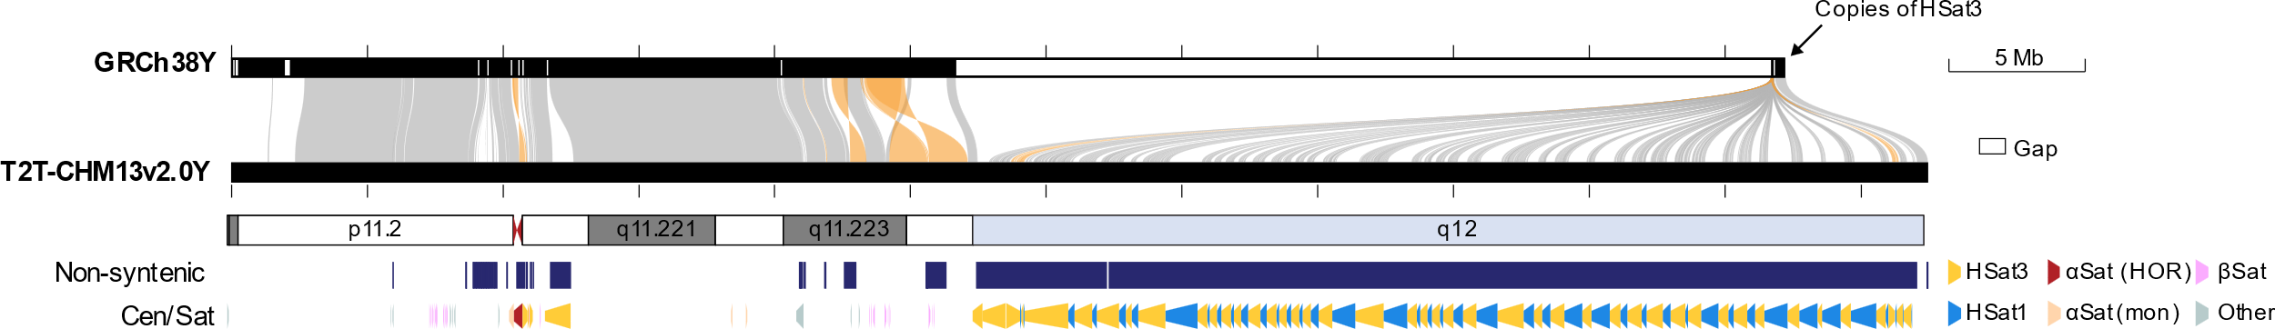

A telomere-to-telomere Y chromosome
CHM13 is an XX complete hydatidiform mole
T2T-CHM13 v1 used the GRCh38 Y chromosome
More than 50% of the GRCh38 Y chromosome assembly is missing
Used long-read sequencing to generate a complete Y chromosome assembly from HG002 cell line, completing the T2T-CHM13 v2.0 reference
Arang Rhie
Notes:
30 Mb heterochromatic region – alternating satellite sequences Hsat1 and Hsat3

Slide 34
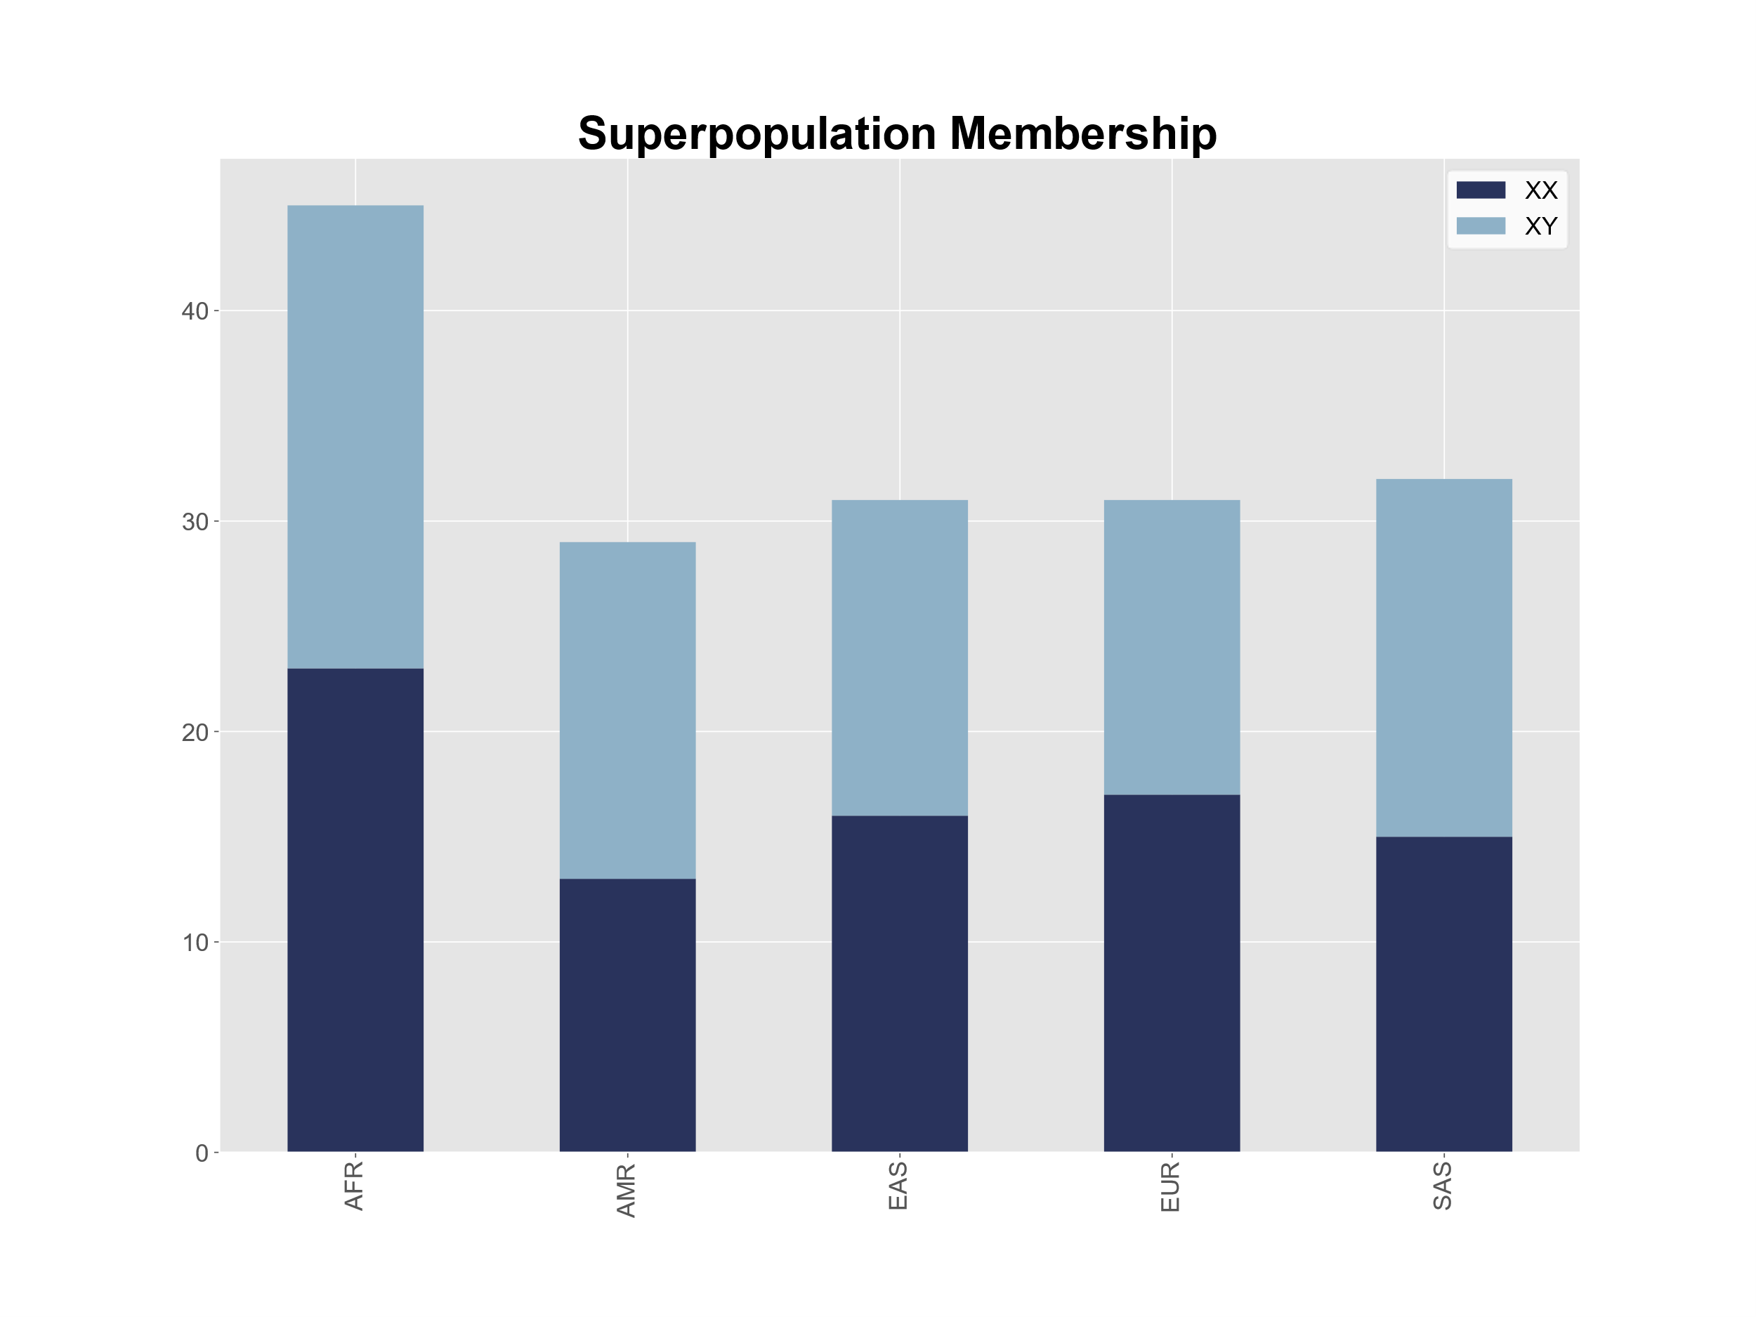
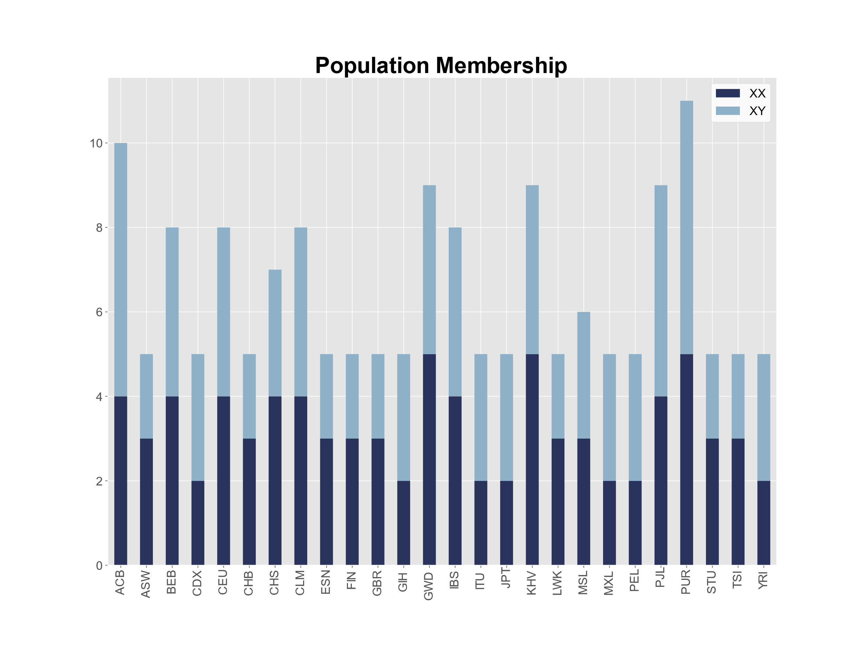
Analyzing diverse, short-read data with T2T-CHM13 v2.0
1000 Genomes Project (1KGP): 168 samples (84 XX, 84 XY)
30x sequencing by the New York Genome Center
Byrska-Bishop et al., 2021, bioRxiv. High coverage whole genome sequencing of the expanded 1000 Genomes Project cohort including 602 trios.

Slide 35
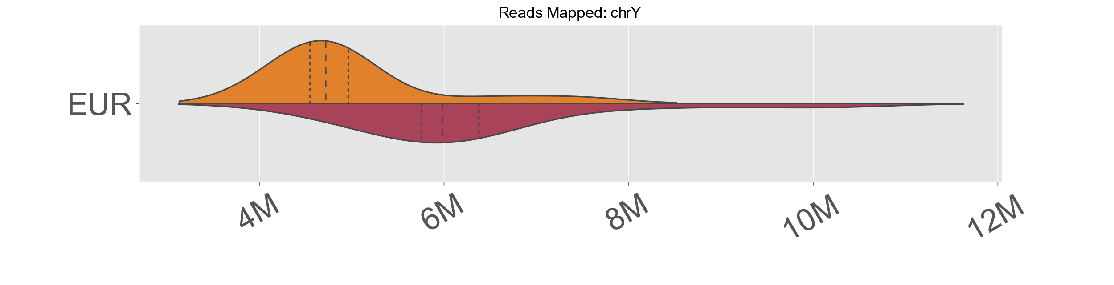
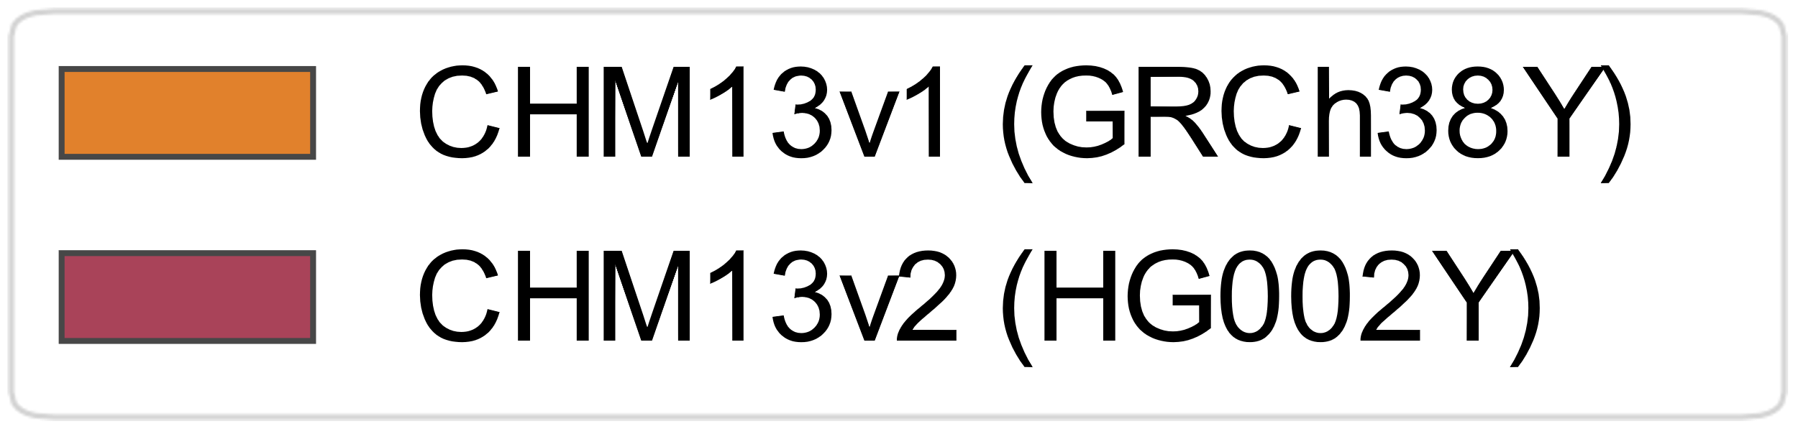
HG002Y improves short-read alignment
Reads Mapped (chrY)
Notes:
first we compared alignment of all of this short-read data between these two reference genomes. On all of the plots I’m going to show, lighter orange is GRCh38 and deeper red is CHM13
this histogram represents the read mismatch rate for the european population of 1000 Genomes. I’m just showing one population for simplicity, but we observe the same patterns across all populations

Slide 36
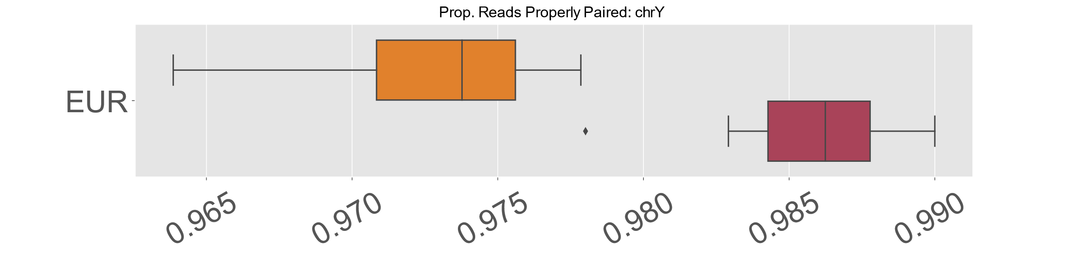
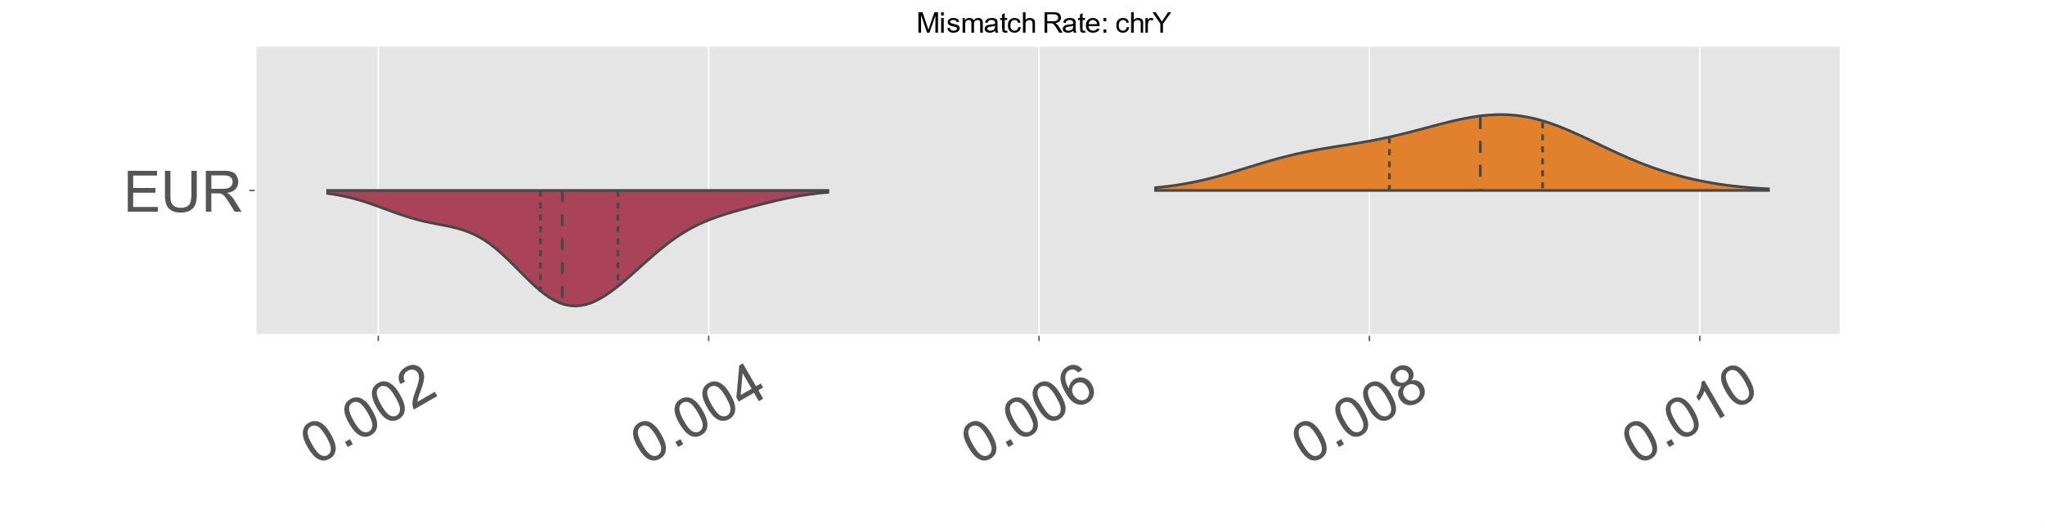
HG002Y improves short-read alignment
Reads Mapped (chrY)
Proportion of reads properly paired (chrY)
Mismatch rate (chrY)
Notes:
first we compared alignment of all of this short-read data between these two reference genomes. On all of the plots I’m going to show, lighter orange is GRCh38 and deeper red is CHM13
this histogram represents the read mismatch rate for the european population of 1000 Genomes. I’m just showing one population for simplicity, but we observe the same patterns across all population

Slide 37
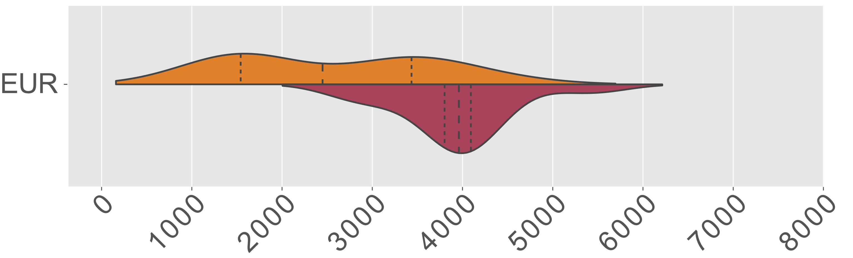
HG002Y improves variant calling in diverse samples
Variants per sample (chrY)

Slide 38
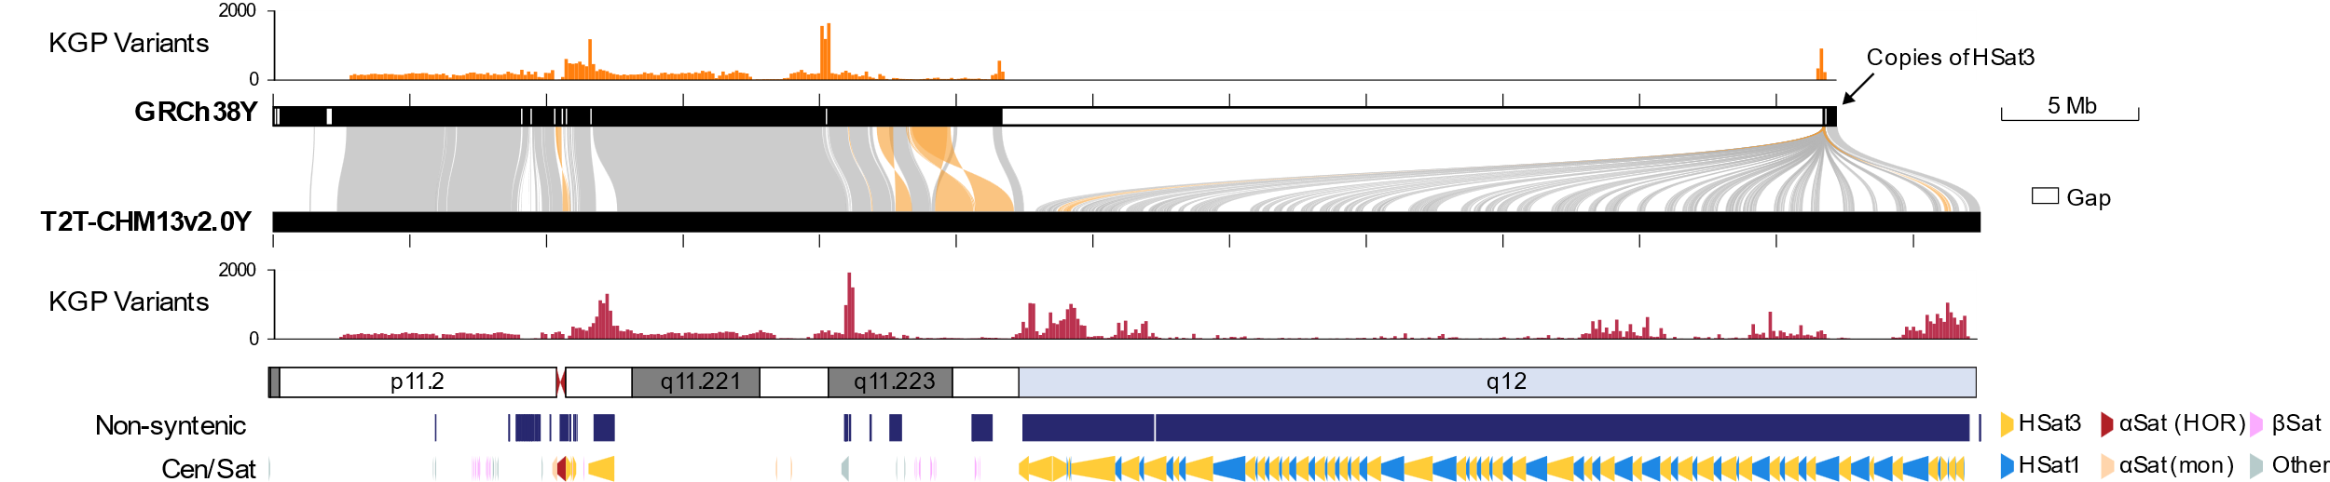
HG002Y improves variant calling in diverse samples
Variants per sample (chrY)

Slide 39
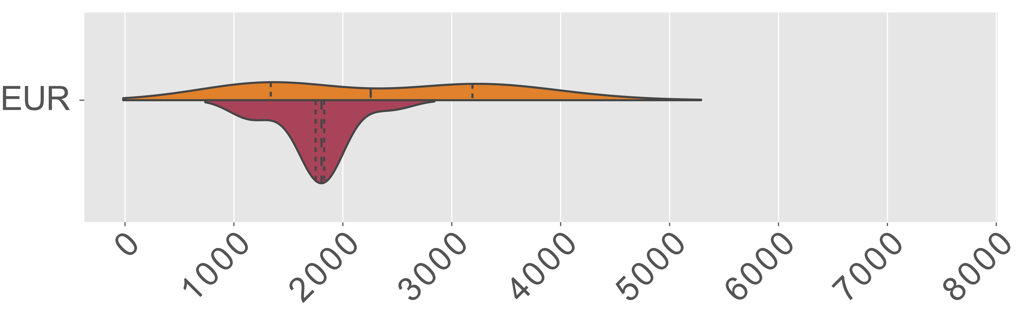
HG002Y improves variant calling in diverse samples
Variants per sample (chrY syntenic)

Slide 40
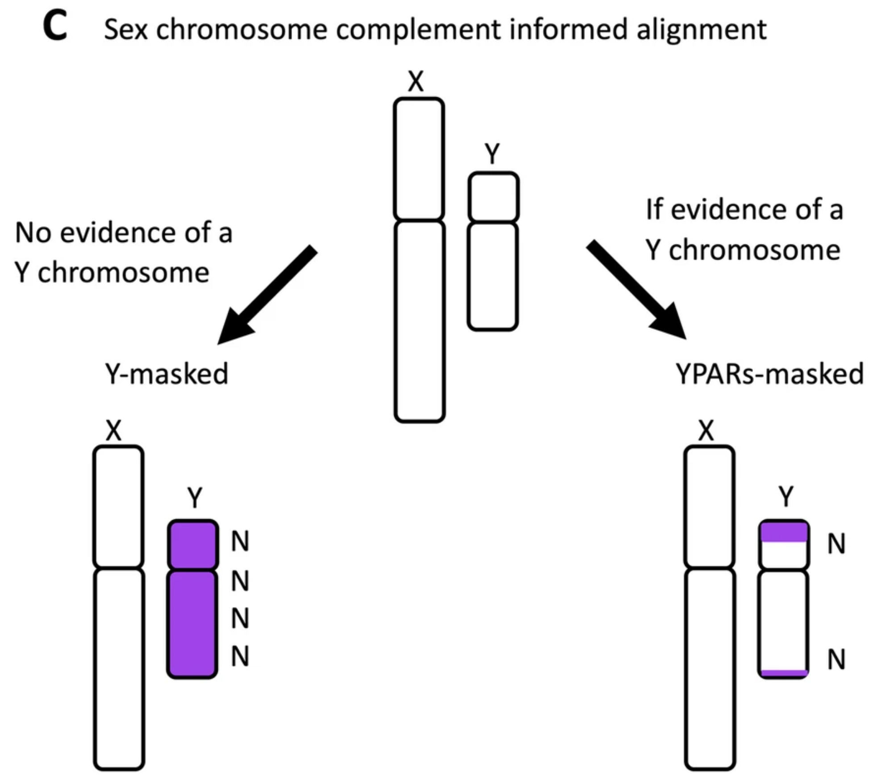
Pseudo-autosomal regions on the sex chromosomes
XX Samples
XY Samples
Adapted from Olney, K. C., et al. (2020) BMC
Notes:
Melissa Wilson’s group
XX samples: Hard masks the Y chromosome
XY samples: PAR regions of Y chromosome hard masked; reads aligning to the PAR regions are forced to align to the X chromosome
Note with this approach it will be impossible to distinguish between variants truly originating from the X chromosome vs those on Y that happen to fall in the PAR region

Slide 41
Karyotype-specific alignment
Used XYalign for alignment
XX Samples
XY Samples
Adapted from Olney, K. C., et al. (2020) BMC
Webster, T. H., et al., 2019, GigaScience. Identifying, understanding, and correcting technical artifacts on the sex chromosomes in next-generation sequencing data.
Notes:
Melissa Wilson’s group
XX samples: Hard masks the Y chromosome
XY samples: PAR regions of Y chromosome hard masked; reads aligning to the PAR regions are forced to align to the X chromosome
Note with this approach it will be impossible to distinguish between variants truly originating from the X chromosome vs those on Y that happen to fall in the PAR region

Slide 42
Karyotype-specific alignment
Used XYalign for alignment
Variant Calling Pipeline
XX samples
chrX: diploid
chrY: hard masked
XY samples:
chrX PAR: diploid
chrX non-PAR: haploid
chrY non-PAR: haploid
chrY PAR: hard masked
XX Samples
XY Samples
Samantha Zarate
Adapted from Olney, K. C., et al. (2020) BMC
Webster, T. H., et al., 2019, GigaScience. Identifying, understanding, and correcting technical artifacts on the sex chromosomes in next-generation sequencing data.
Notes:
Melissa Wilson’s group
XX samples: Hard masks the Y chromosome
XY samples: PAR regions of Y chromosome hard masked; reads aligning to the PAR regions are forced to align to the X chromosome
Note with this approach it will be impossible to distinguish between variants truly originating from the X chromosome vs those on Y that happen to fall in the PAR region

Slide 43
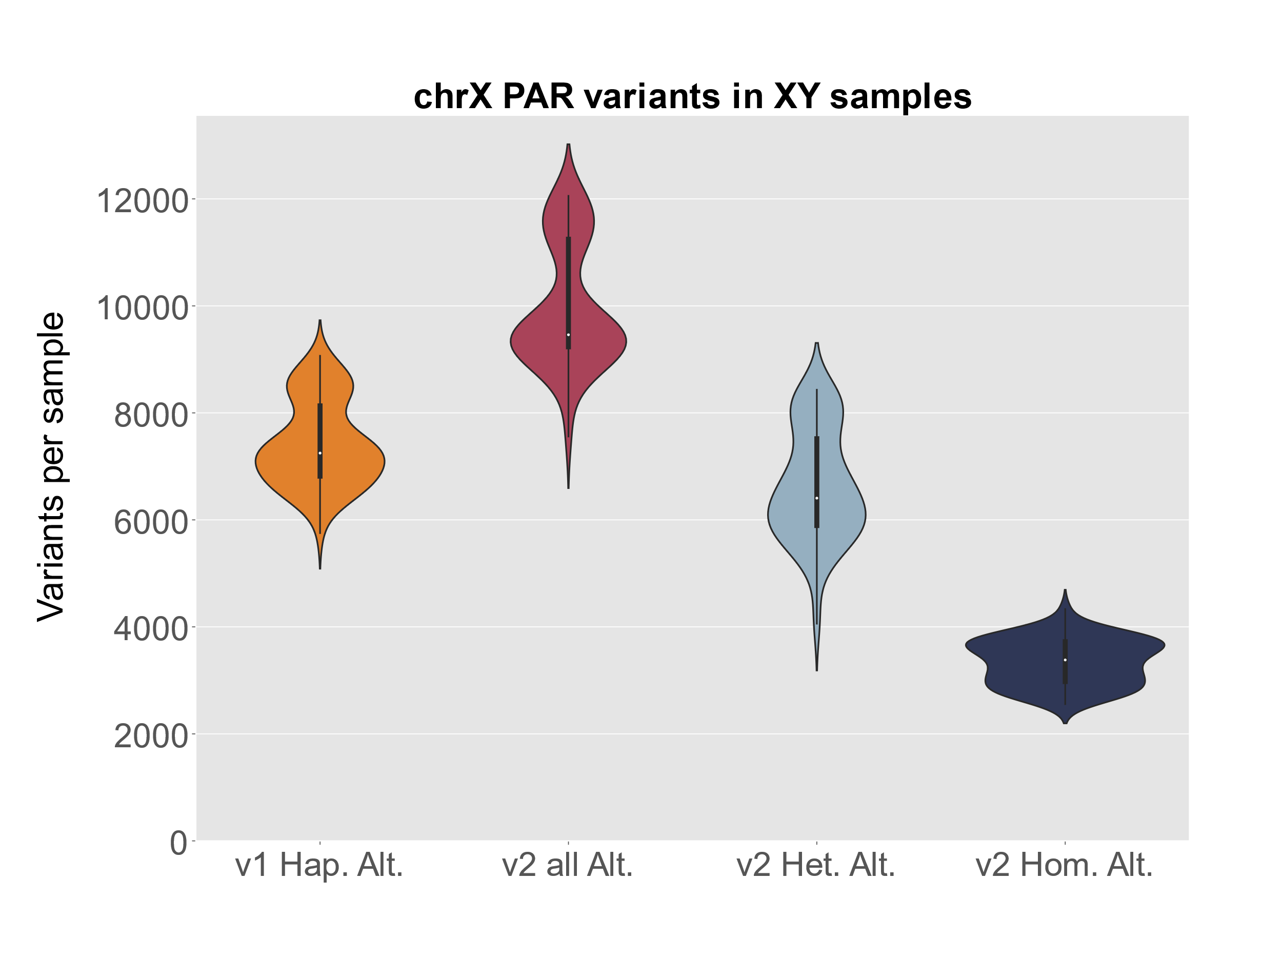
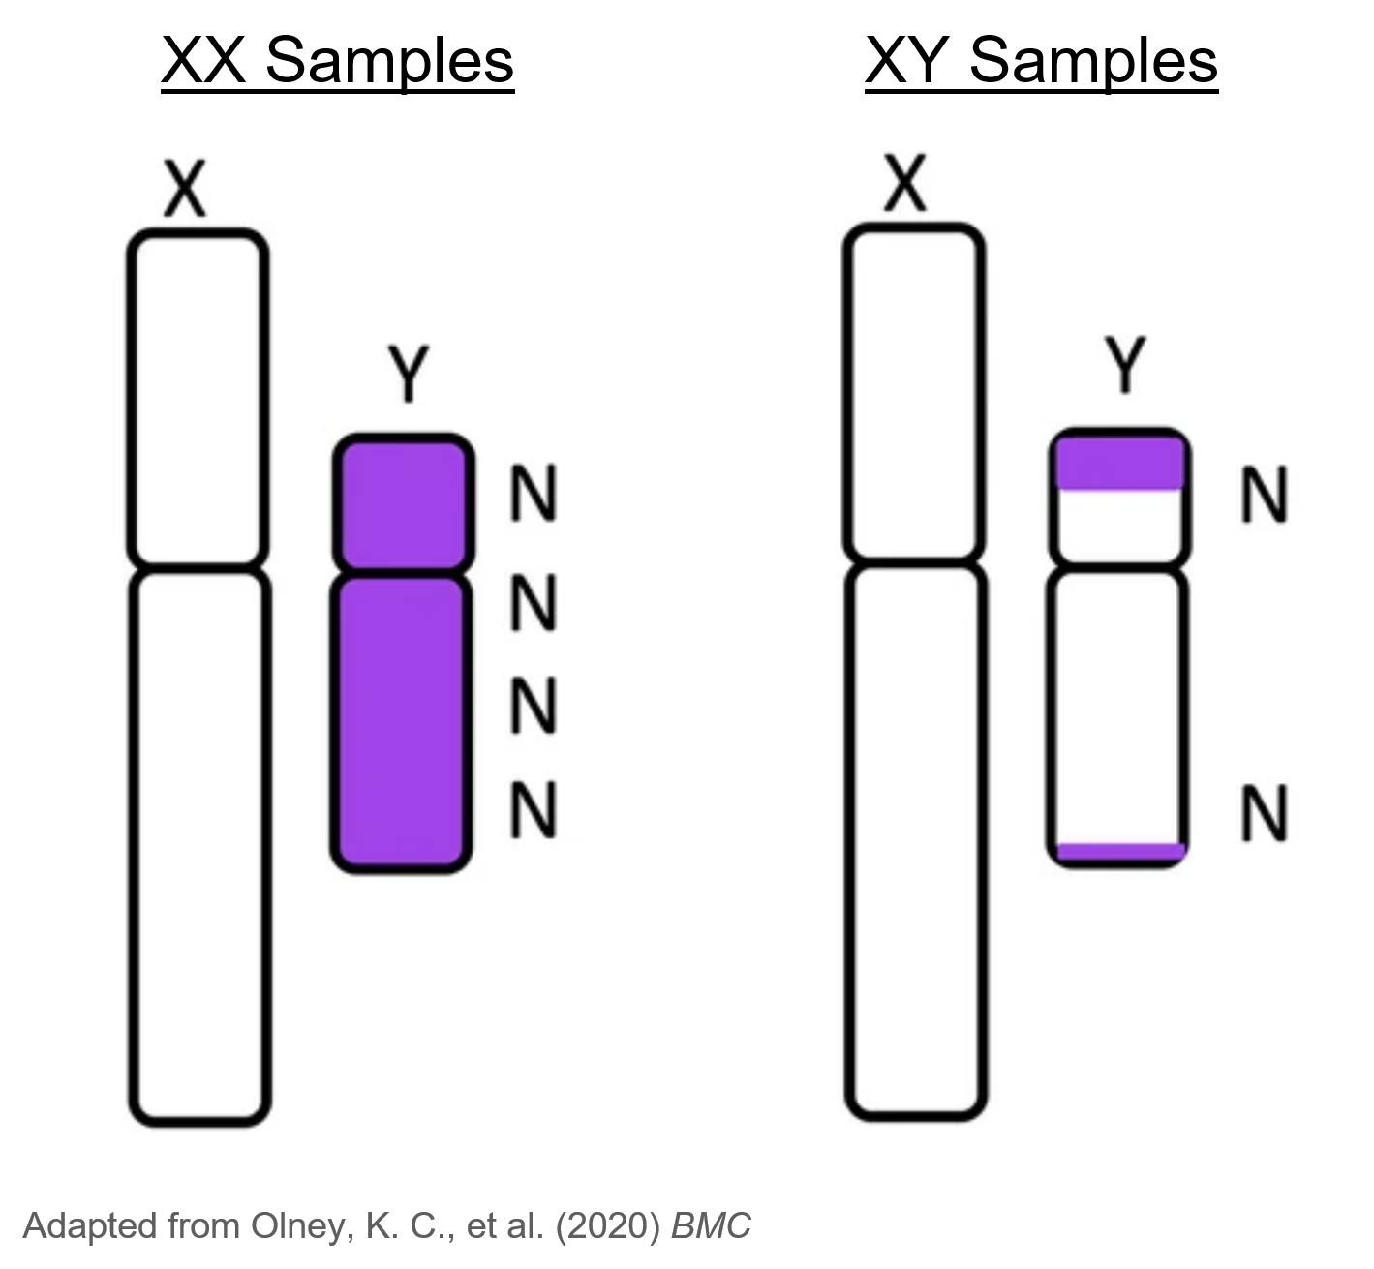
Karyotype-specific alignment elucidates PAR genotypes
Samantha Zarate
Webster, T. H., et al., 2019, GigaScience. Identifying, understanding, and correcting technical artifacts on the sex chromosomes in next-generation sequencing data.

Slide 44
Karyotype-specific alignment elucidates PAR genotypes
Samantha Zarate
Webster, T. H., et al., 2019, GigaScience. Identifying, understanding, and correcting technical artifacts on the sex chromosomes in next-generation sequencing data.
Notes:
Melissa Wilson’s group
Note with this approach it will be impossible to distinguish between variants truly originating from the X chromosome vs those on Y that happen to fall in the PAR region

Slide 45
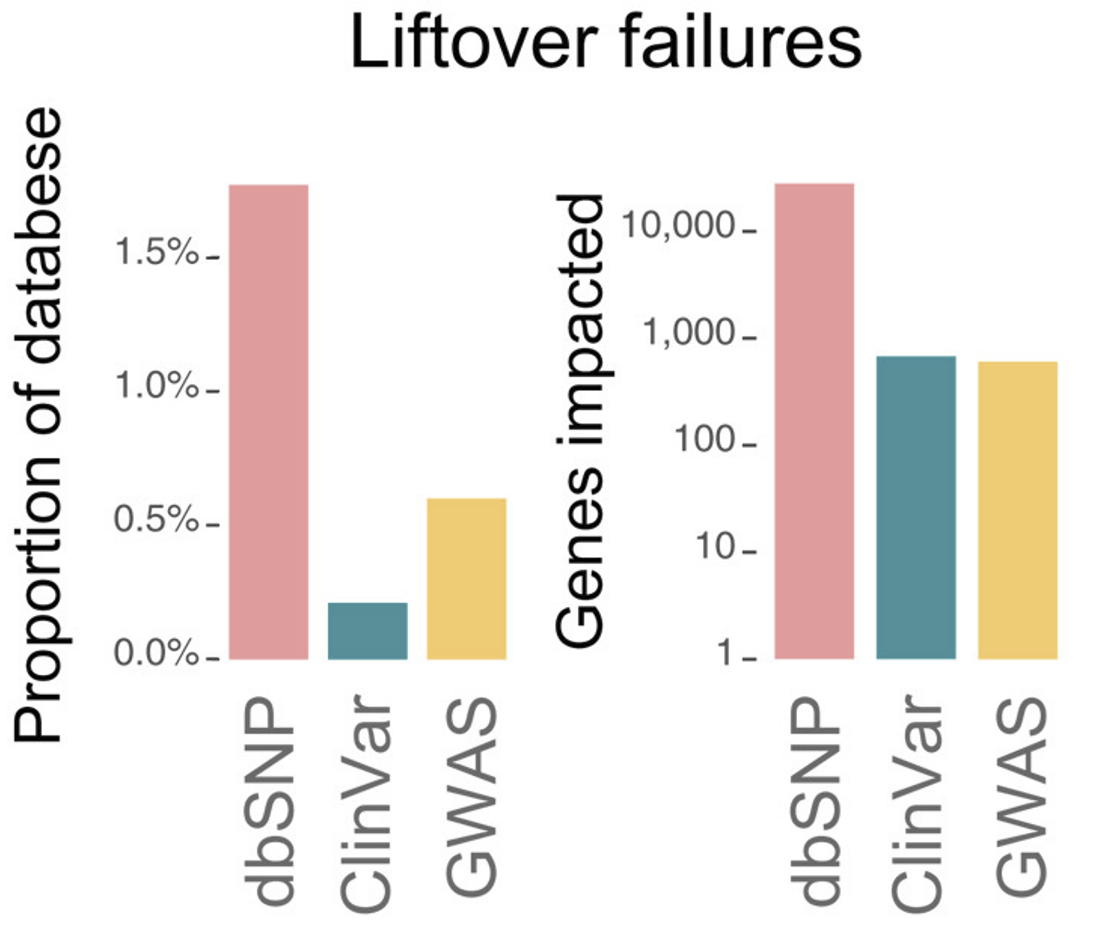
Liftover of genetic variation databases to T2T-CHM13
Lifted ClinVar, NCBI dbSNP, and NHGRI-EBI GWAS Catalog to CHM13
Notes:
800,942 / 802,674 (99.8%) variants in the ClinVar
723,117,125 / 736,178,420 (98.2%) variants from dbSNP database
150,962 / 151,876 (99.4%) NHGRI-EBI GWAS Catalog variants
138,319 / 138,927 (99.6%) ClinVar variants annotated as “pathogenic” or “likely pathogenic.”
Of the 1732 ClinVar variants that failed to lift over, 1186 overlap documented insertions or deletions that distinguish the GRCh38 and T2T-CHM13 assemblies.
The remaining 546 variants (<0.1% of all variants) lie within regions of poor alignment between the GRCh38 and T2T-CHM13 assemblies (Fig. 1E).

Slide 46
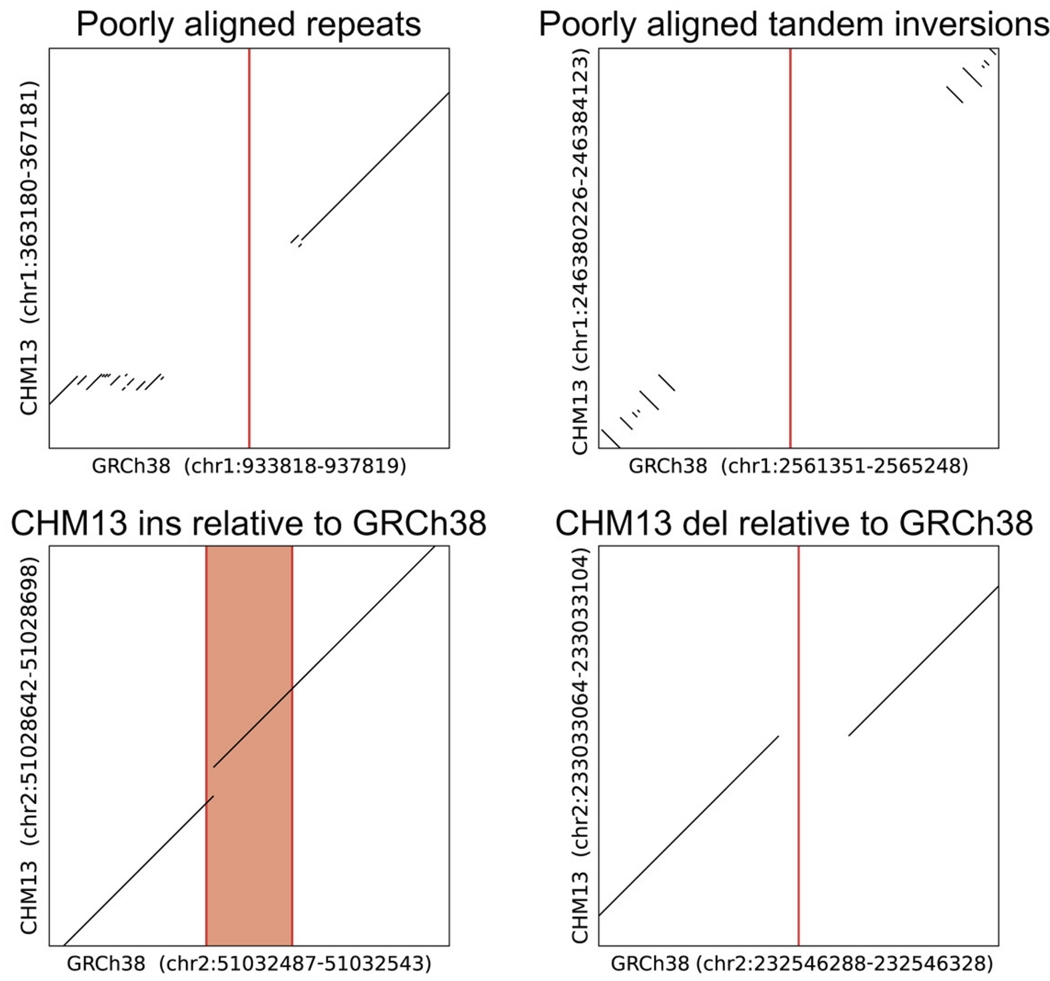
Liftover of genetic variation databases to T2T-CHM13
Lifted ClinVar, NCBI dbSNP, and NHGRI-EBI GWAS Catalog to CHM13v1.1
Notes:
800,942 / 802,674 (99.8%) variants in the ClinVar
723,117,125 / 736,178,420 (98.2%) variants from dbSNP database
150,962 / 151,876 (99.4%) NHGRI-EBI GWAS Catalog variants
138,319 / 138,927 (99.6%) ClinVar variants annotated as “pathogenic” or “likely pathogenic.”
Of the 1732 ClinVar variants that failed to lift over, 1186 overlap documented insertions or deletions that distinguish the GRCh38 and T2T-CHM13 assemblies.
The remaining 546 variants (<0.1% of all variants) lie within regions of poor alignment between the GRCh38 and T2T-CHM13 assemblies (Fig. 1E).

Slide 47
Liftover of genetic variation databases to HG002Y
Lifted ClinVar, NCBI dbSNP, and NHGRI-EBI GWAS Catalog from GRCh38 chrY to HG002 chrY
 | Number of Variants
Database | GRCh38 | Lifted to T2T-CHM13v2.0 | Failed liftover to T2T-CHM13v2.0
dbSNP155 (chrY) | 2,480,588 | 2,355,634 (95.0%) | 124,954 (5.0%)
Clinvar (chrY) | 48 | 48 (100%) | 0
GWAS Catalog (chrY) | 26 | 26 (100%) | 0

Slide 48

The future of Telomere-to-telomere assemblies
Collaboration with the Human Pangenome Reference Consortium (HPRC) — more Telomere-to-Telomere human genomes!
Generate a high-quality reference capturing the scope of human genetic diversity
Notes:
T2T genomes being worked on in flies, ruminants,

Slide 49
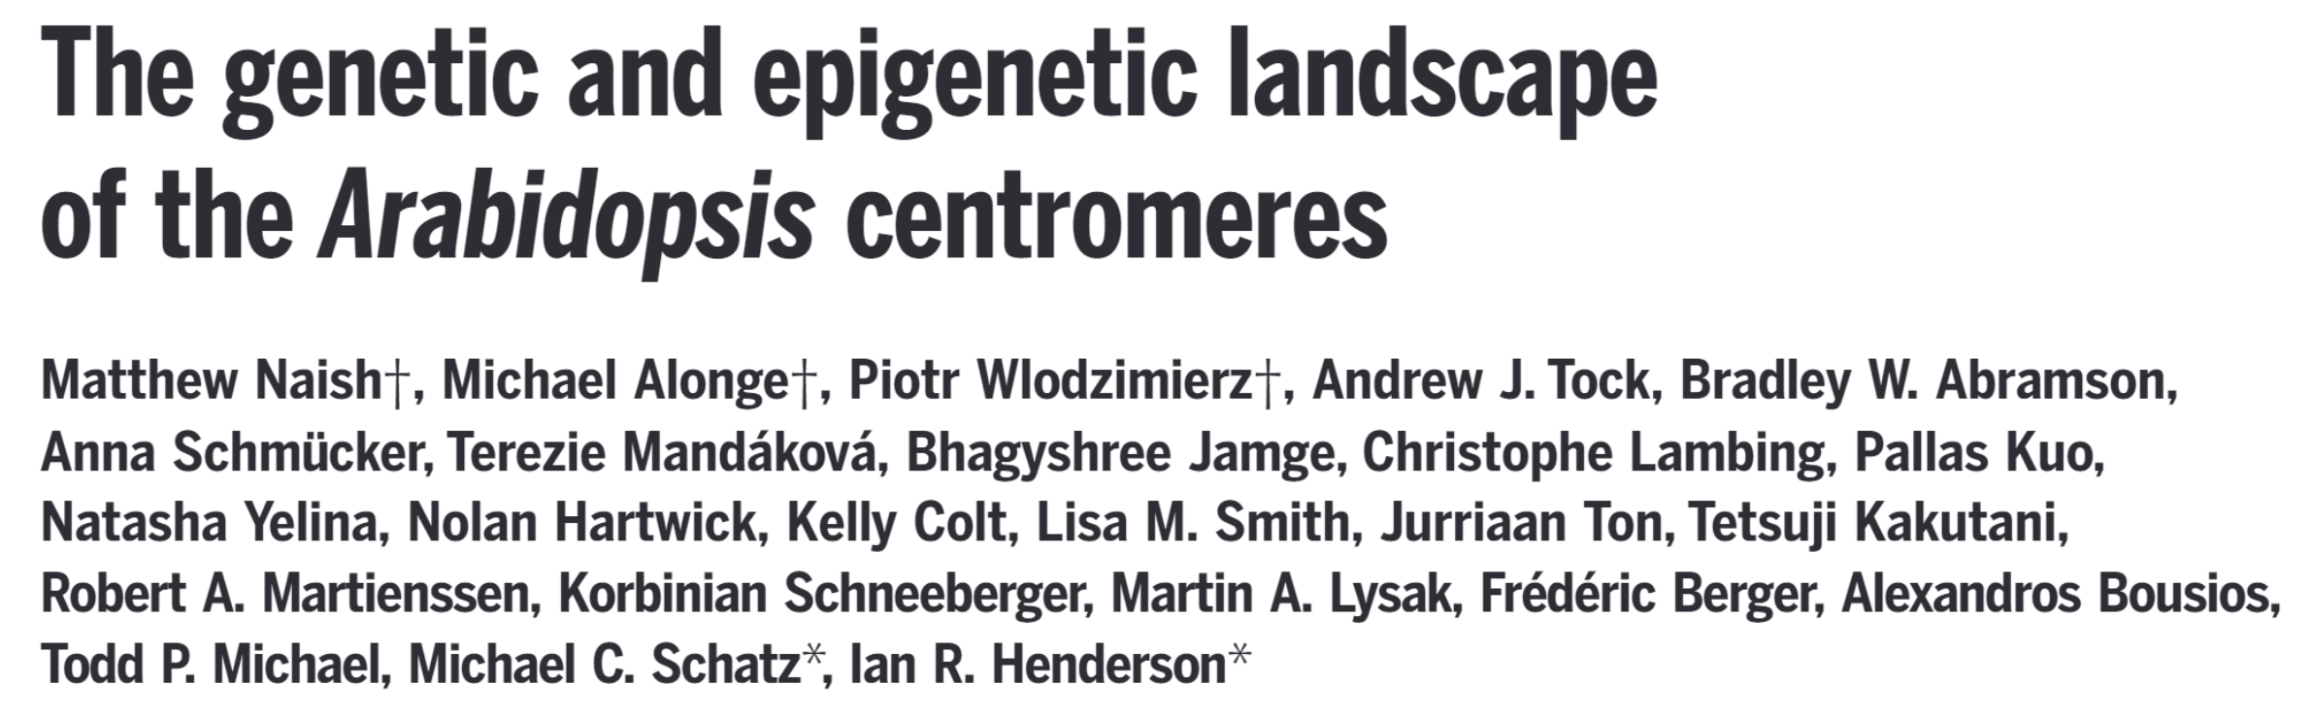
The future of Telomere-to-telomere assemblies
Collaboration with the Human Pangenome Reference Consortium (HPRC) — more Telomere-to-Telomere human genomes!
Generate a high-quality reference capturing the scope of human genetic diversity
Produce more complete genomes for organisms across the tree of life
Notes:
T2T genomes being worked on in flies, ruminants,

Slide 50
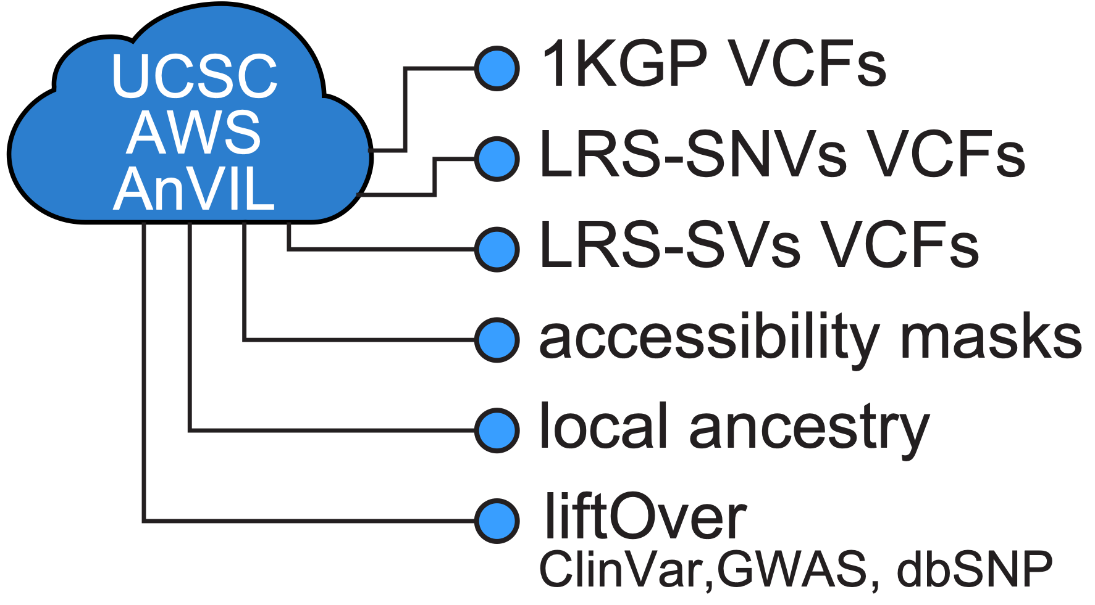
Conclusion
T2T-CHM13 improves alignment and variant calling analysis across all populations
Newly resolved regions of the genome reveal 230 Mbp of sequence for analysis for the first time
A complete telomere-to-telomere assembly of the Y chromosome from HG002
T2T has generated resources for using T2T-CHM13v2.0 as a reference genome
Notes:
using T2T-CHM13 as a reference genome improves genomic analyses
CHM13 also adds 200 mb of sequence that are available for genetic analysis for the first time
this is all great evidence for why you should consider using CHM13 as a reference genome, and to facilitate that, T2T and the GRC have put in a lot of work generating resources for that transition
and finally, what’s next? we’re hoping that CHM13 is just the first step to many more telomere-to-telomere genome assemblies, for more diverse genomes, which is being worked on by the human pangenome reference consortium right now

Slide 51




Thank you!
T2T Variants
Mike Schatz
Sergey Aganezov
Steph Yan
Daniela Soto
Melanie Kirsche
Samantha Zarate
Megan Dennis
Justin Zook
Rajiv McCoy
Arang Rhie
…and many many more!
Aganezov S*, Yan SM*, Soto DC*, Kirsche M*, Zarate S*, et al., Science, 2022

Slide 52
extra slides

Slide 53
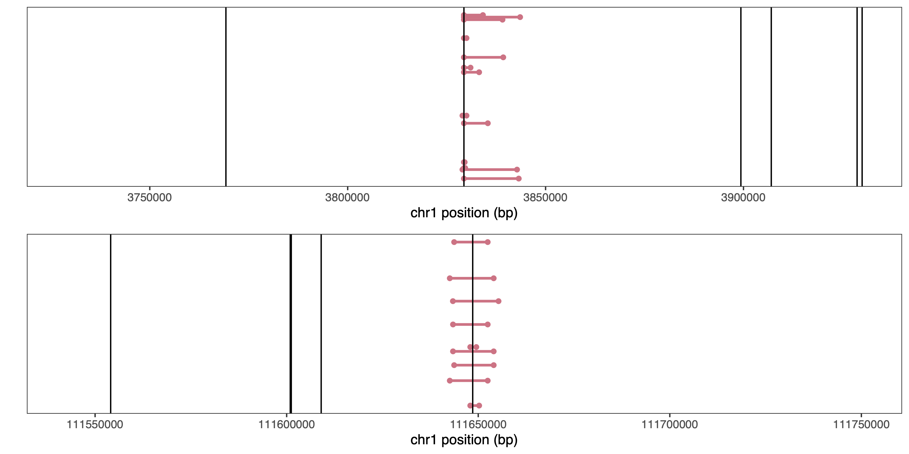
GRCh38 contains artificial haplotype boundaries
Rajiv McCoy

Slide 54
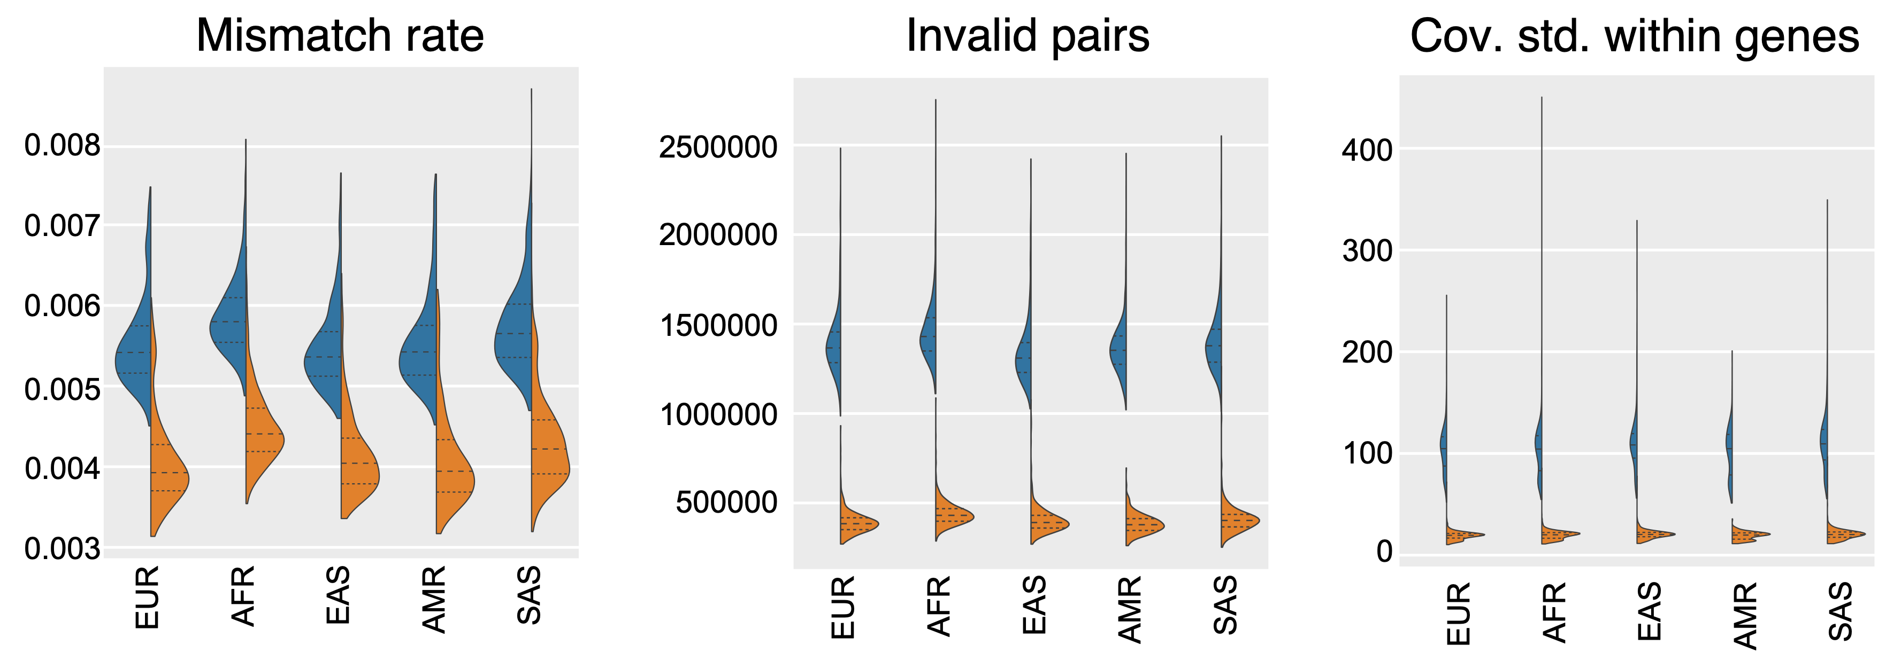
T2T-CHM13 improves short-read alignment
Sergey Aganezov

Slide 55
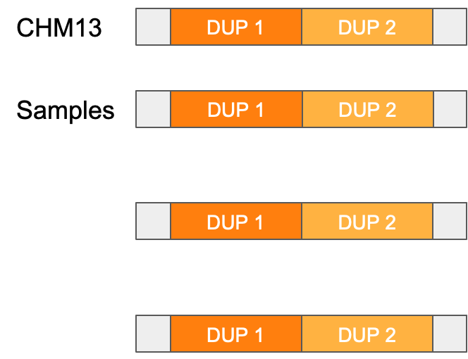
T2T-CHM13 improves short-read variant calling
Fewer false heterozygous variants from GRCh38 collapsed duplications
Samantha Zarate

Slide 56
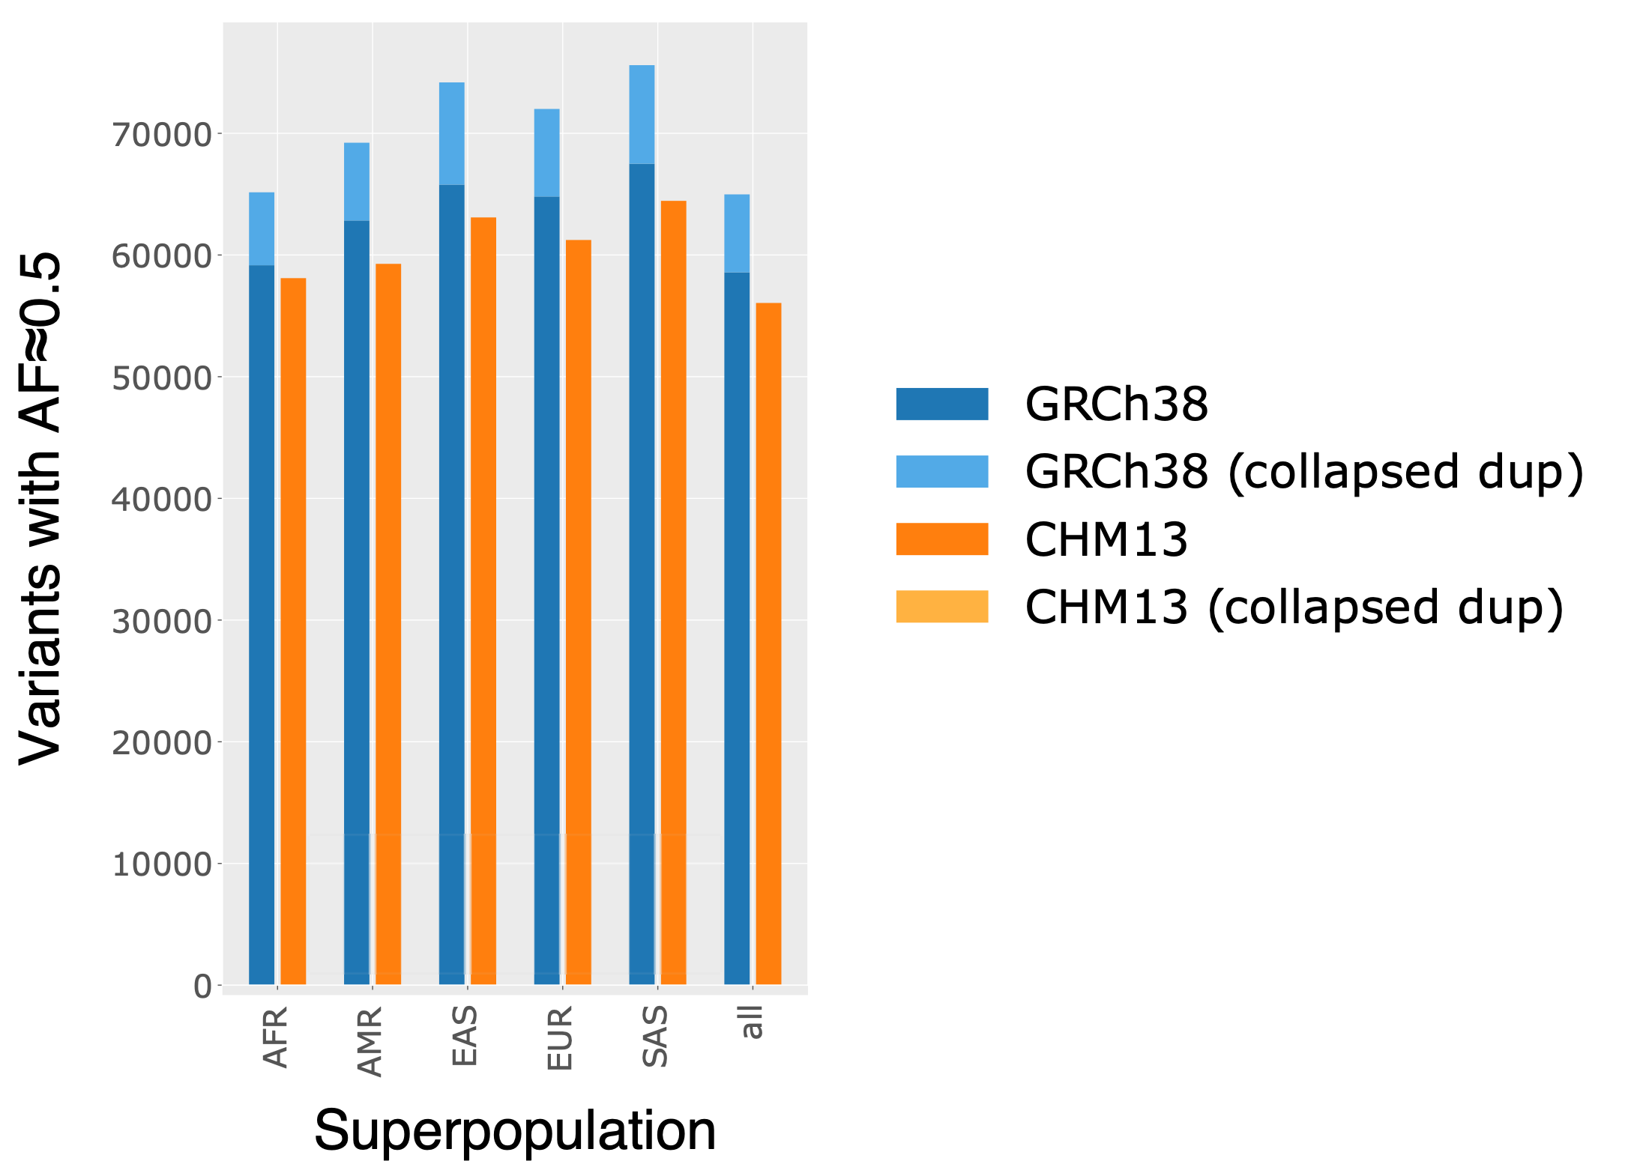
T2T-CHM13 improves short-read variant calling
Fewer spurious heterozygous variants from GRCh38 collapsed duplications
Samantha Zarate
Notes:
to back this up, when you look at all variants with AF 0.5, you see that GRCh38 has an overall higher number of these variants, and that the majority of this enrichment is accounted for by variants in collapsed duplication regions

Slide 57
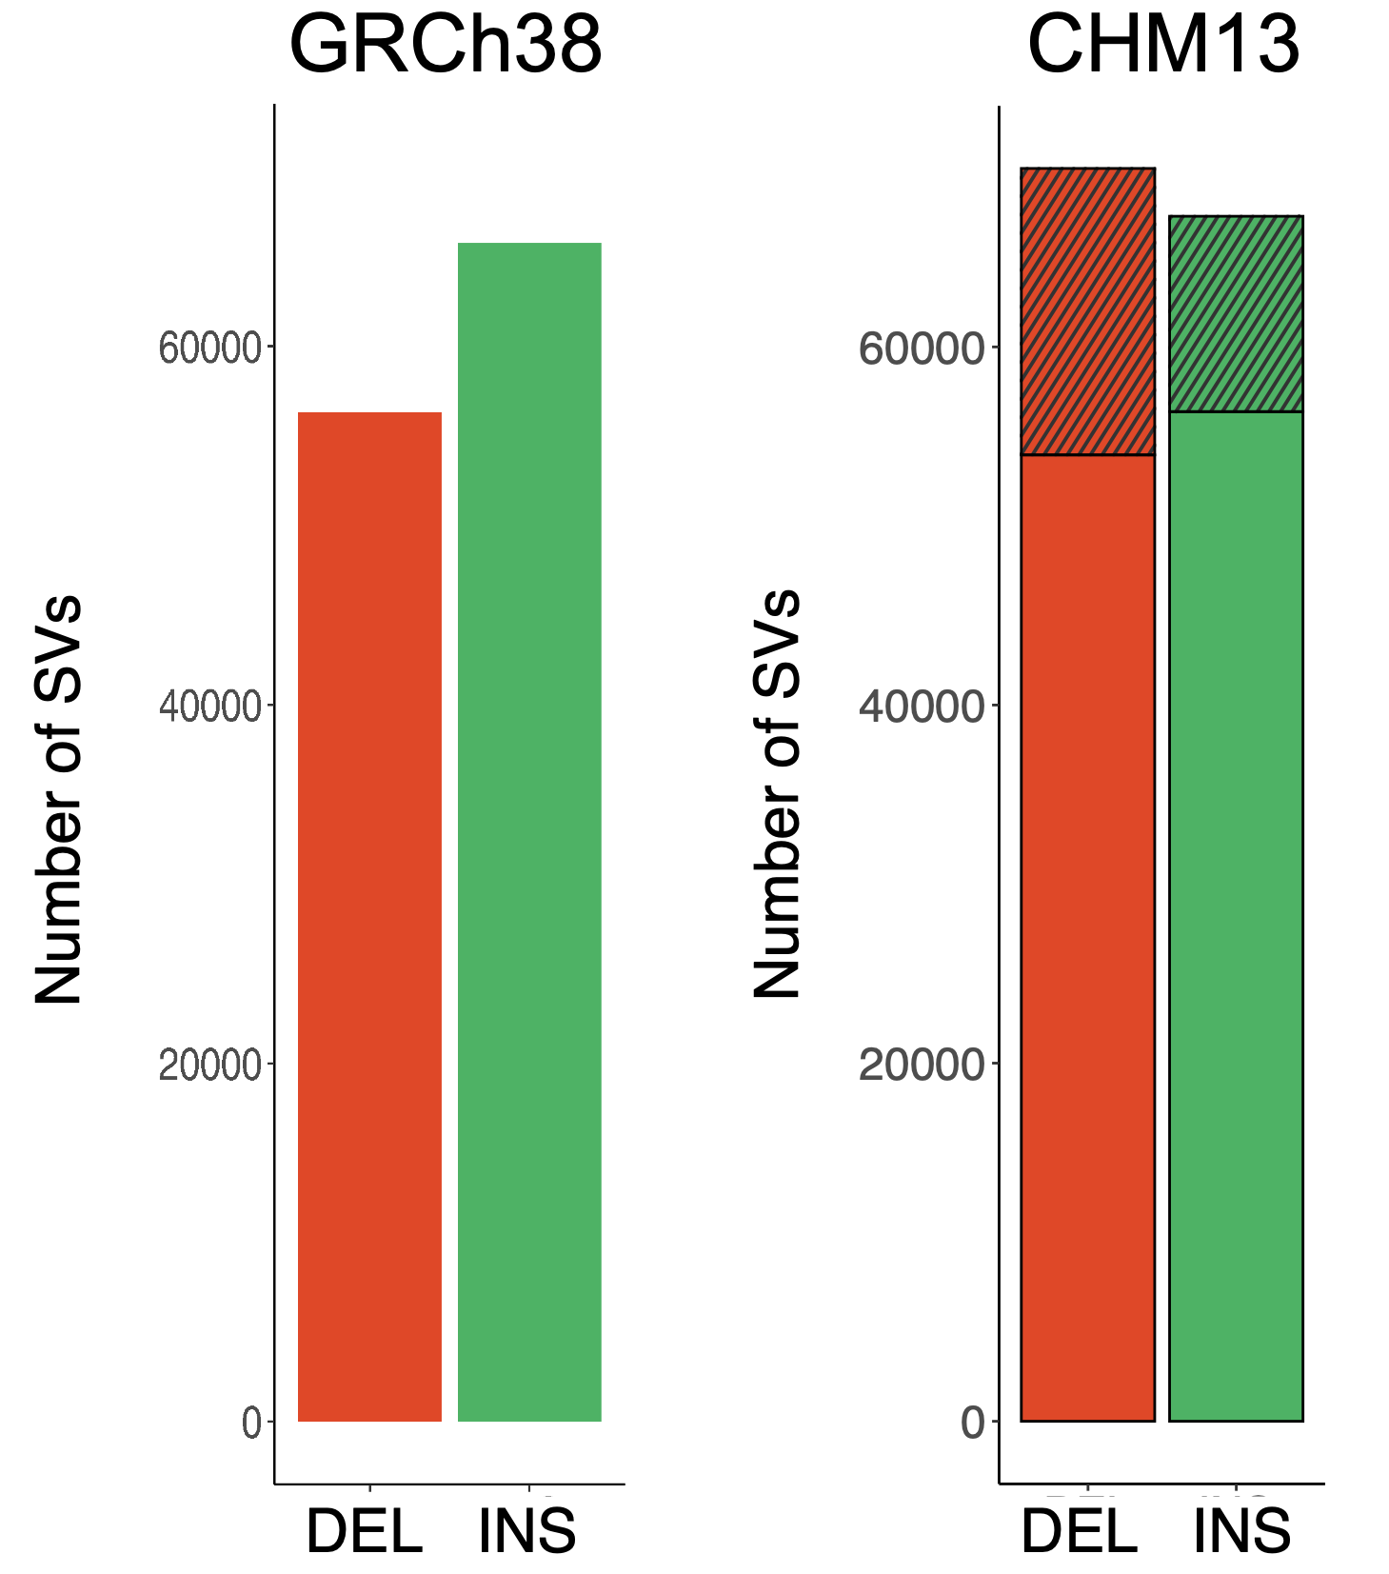
T2T-CHM13 fixes the insertion-deletion misbalance in GRCh38
Excess GRCh38 insertions represent missing or incomplete sequences
Melanie Kirsche
Sergey Aganezov
Notes:
in terms of calling structural variants with long reads, we saw something really cool, which is that CHM13 fixes a known issue with GRCh38
if you use long reads to call SVs on GRCh38, you consistently observe a greater number of insertions than deletions. This enrichment of insertions isn’t a biological phenomenon, it’s actually due to sequences that are missing or incomplete in the GRCh38 reference
if those sequences aren’t in the reference but we can still find them with long reads, we call them as insertions in the genome, even though they’re actually just sequences not in the reference

Slide 58
T2T-CHM13 fixes the insertion-deletion misbalance in GRCh38
Excess GRCh38 insertions represent missing or incomplete sequences
Melanie Kirsche
sequences only in CHM13
Sergey Aganezov
Notes:
if you call SVs on CHM13, you see that the balance of insertions and deletions is almost exactly equal
we actually see a slight bias toward deletions, which reflects the fact that insertions in the genome are generally harder to call than deletions are

Slide 59
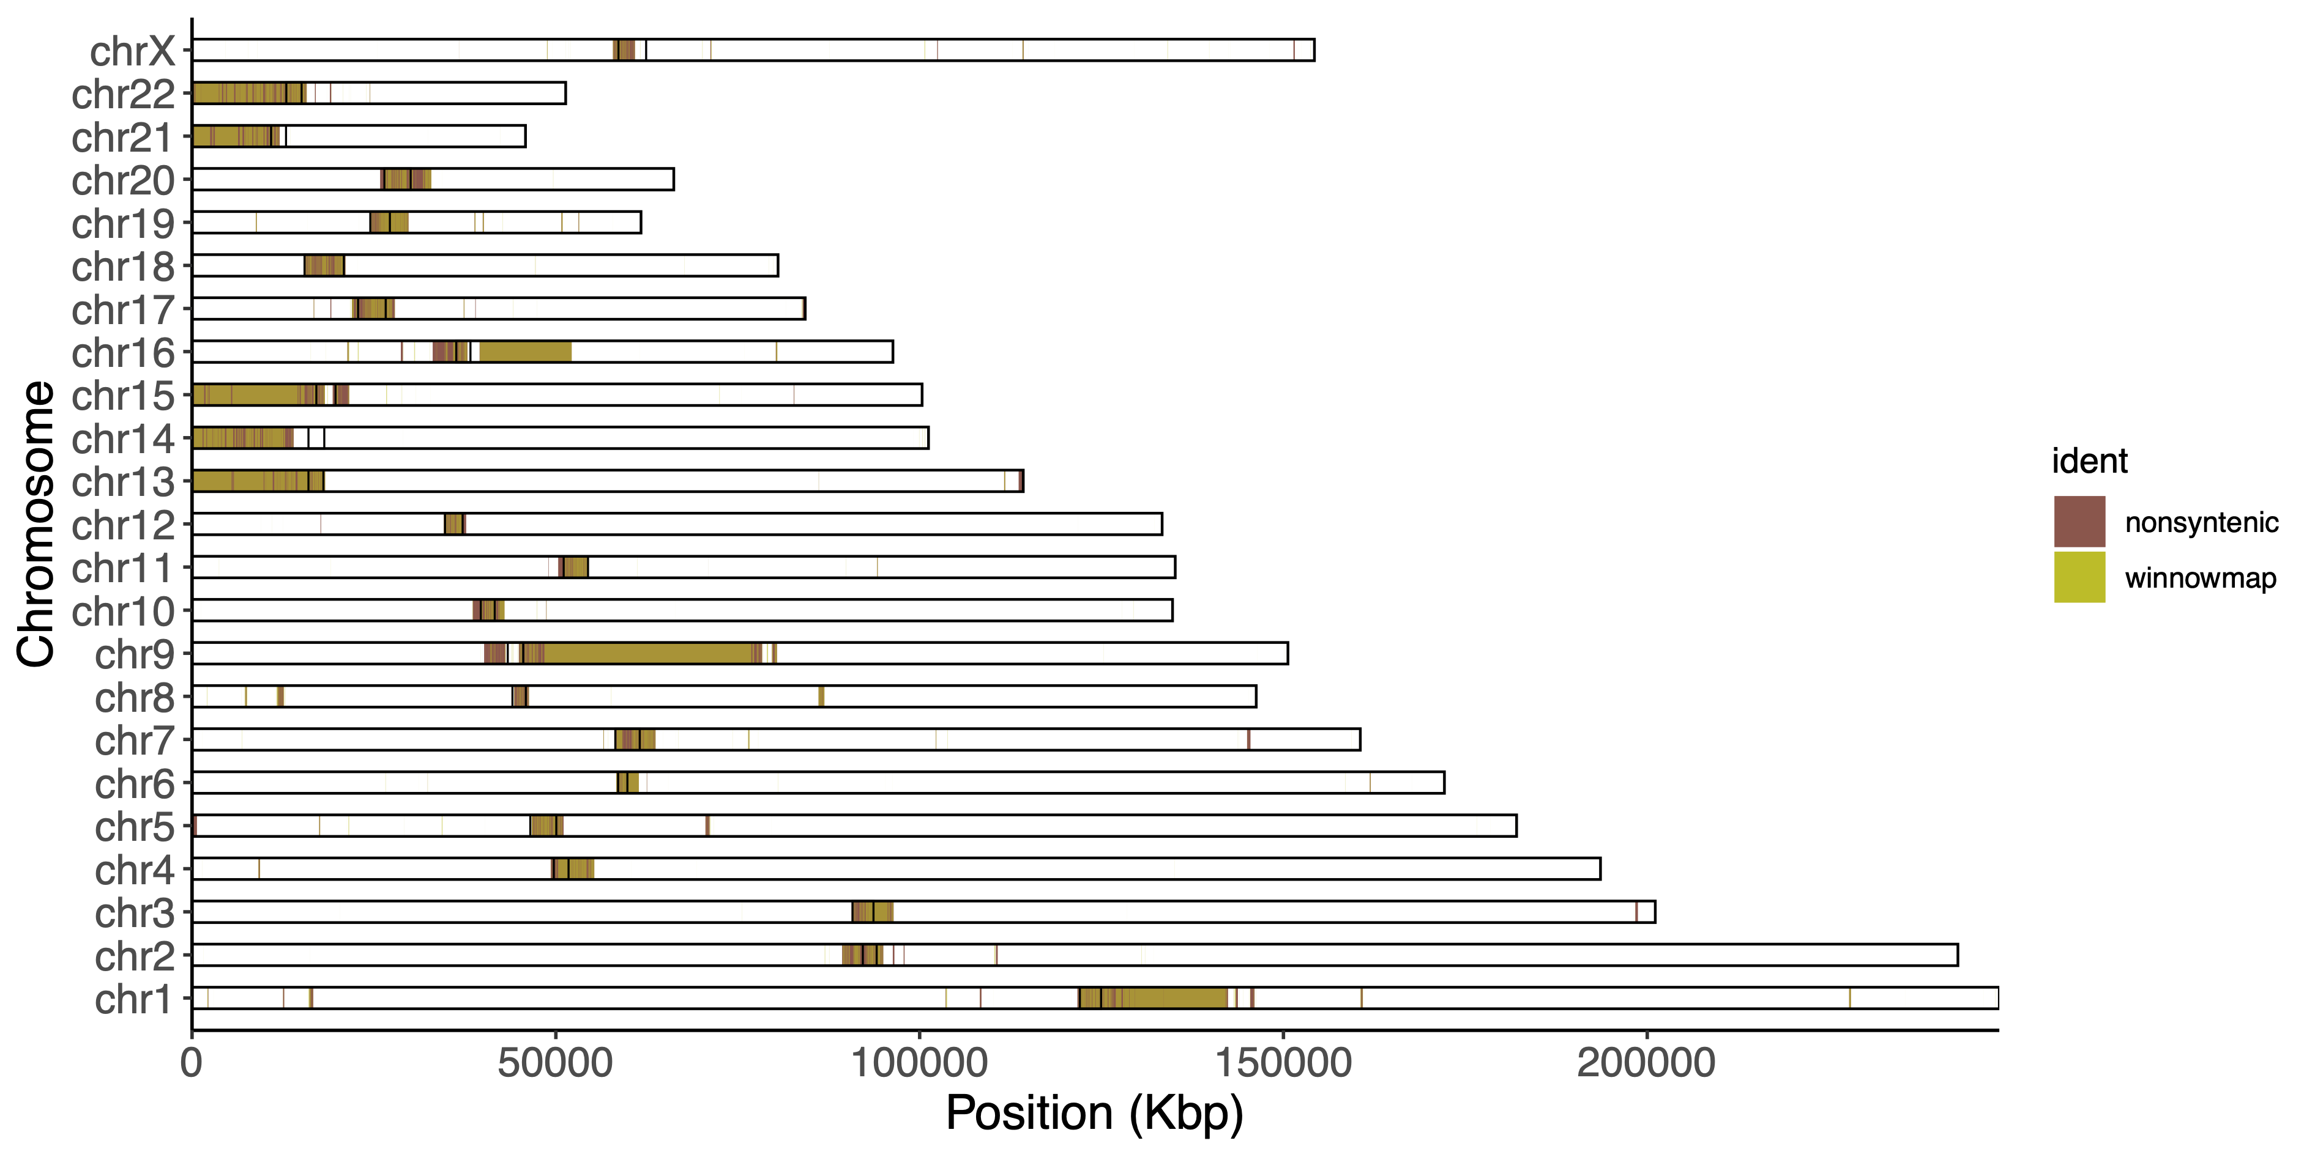
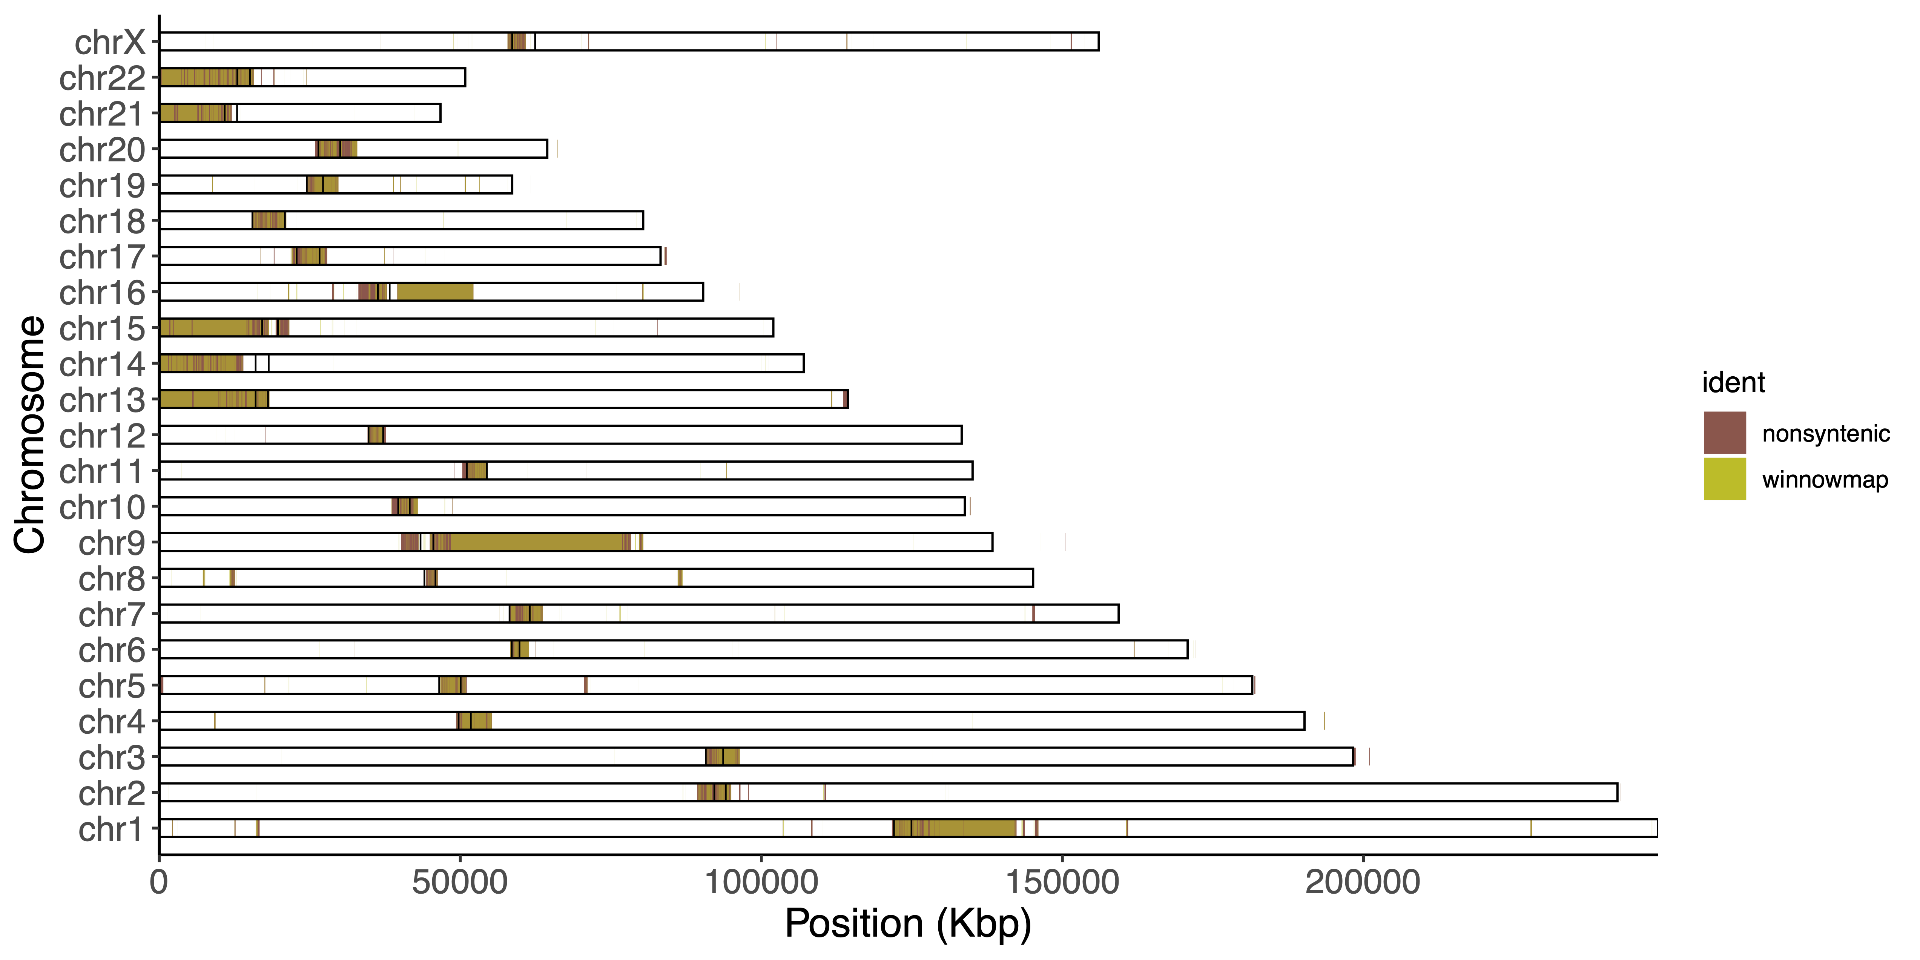
Identifying new sequences revealed by T2T-CHM13
non-syntenic
Non-syntenic | Winnowmap “previously unresolved”
1 Mb regions of T2T-CHM13 without synteny with GRCh38 | Winnowmap alignments of GRCh38 to T2T-CHM13 More strict
winnowmap
Notes:
nonsyntenic (Mitchell Vollger/Mark Diekhans): The T2T CHM13 to GRCh38 synteny track was constructed using the Cactus HAL file with 1 Mbp resolution and a maximum anchor distance of 50 kbp. We used the tool halSynteny to construct syntenic blocks from the Cactus alignments. Repeats masked during seeding
novel (Sergey Koren): Winnowmap v2.0 was used to align GRCh38 (excluding ChrY, patches, and alts) to CHM13 v1.1, primary alignments were converted to paf and filtered for primary only, and converted to unmapped regions by inverting the list of mappings w/MAPQ>0

Slide 60
Long-read alignment and variant calling with T2T-CHM13
17 diverse samples from the Human Pangenome Reference Consortium and Genome in a Bottle
PacBio HiFi data + 14 samples with ONT data
Melanie Kirsche
Sergey Aganezov
Notes:
after benchmarking short reads, we moved on to comparing long-read alignment and variant calling
to do this, we used PacBio and nanopore data from 17 diverse samples, sequenced by the Human Pangenome Reference Consortium and Genome in a Bottle

Slide 61
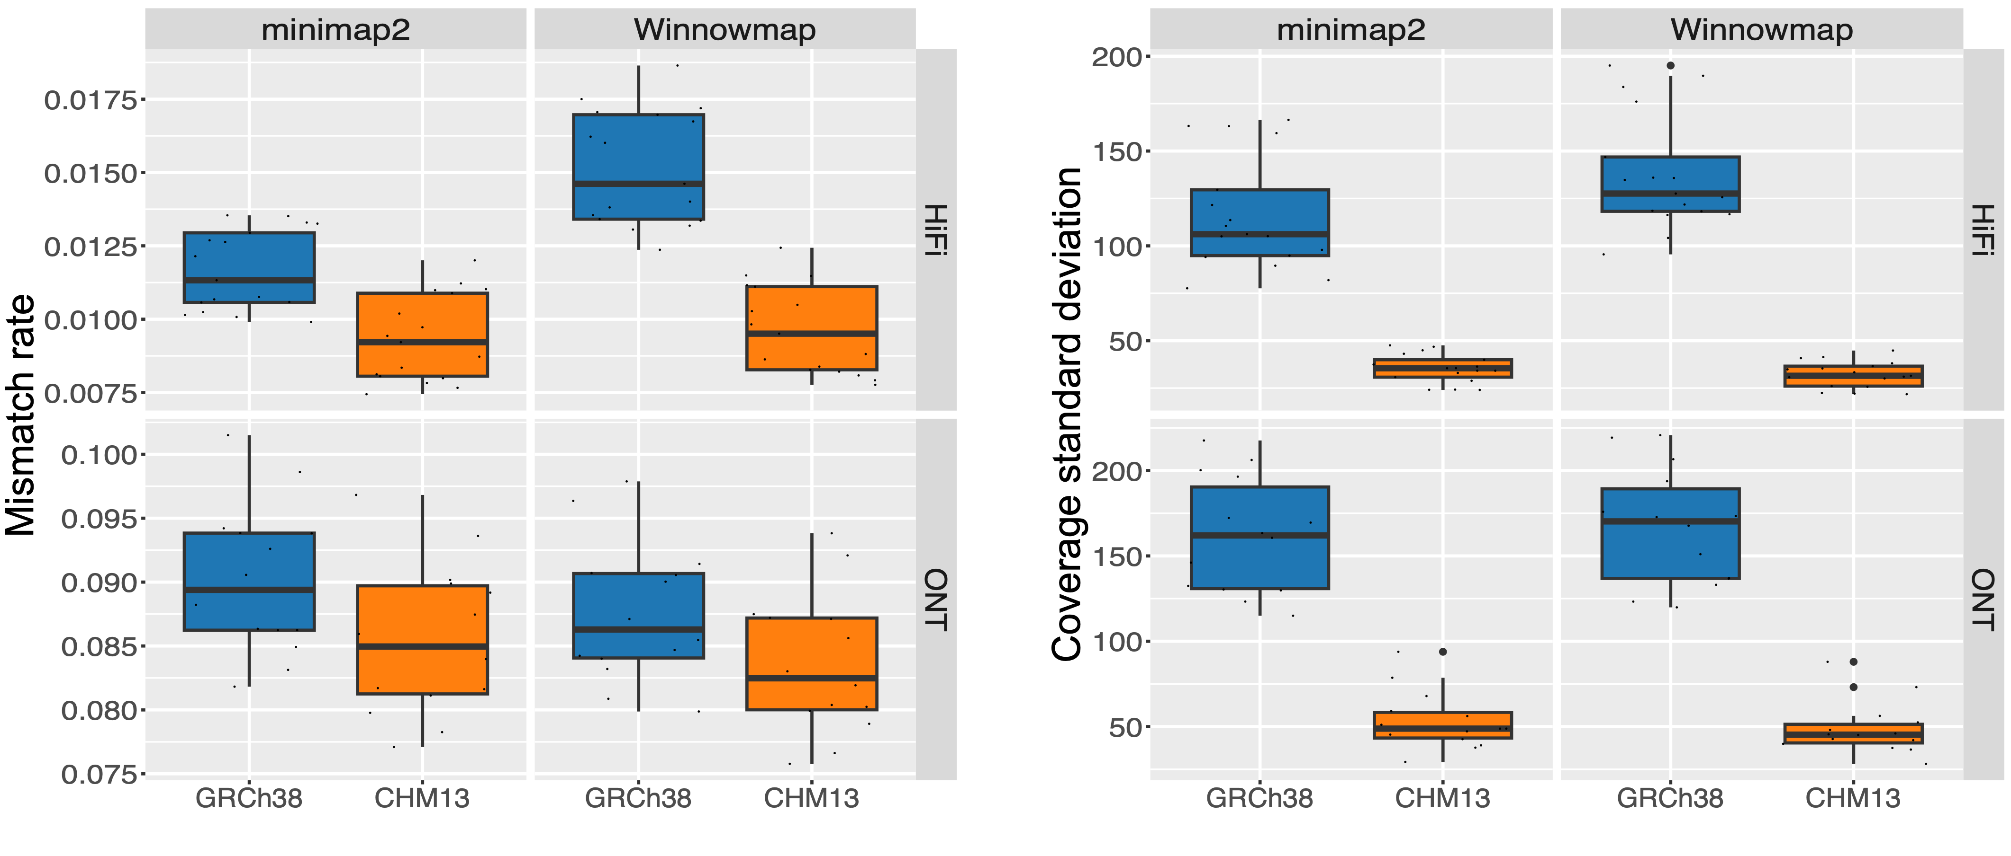
T2T-CHM13 lowers alignment mismatch rates for long reads
Melanie Kirsche
Mismatch rate
Sergey Aganezov
Notes:
we compared long-read alignment to GRCh38 and CHM13 using two different aligners, minimap2 and winnowmap
I’m showing just one of the metrics we compared here, which is read mismatch rate, and you can see that when using pacbio HiFi data for both of these aligners, we observe a lower rate of mismatch when aligning to CHM13

Slide 62
T2T-CHM13 lowers alignment mismatch rates for long reads
Melanie Kirsche
Mismatch rate
Sergey Aganezov
Notes:
and we see a similar pattern when we look at mismatch rate for the nanopore data

Slide 63
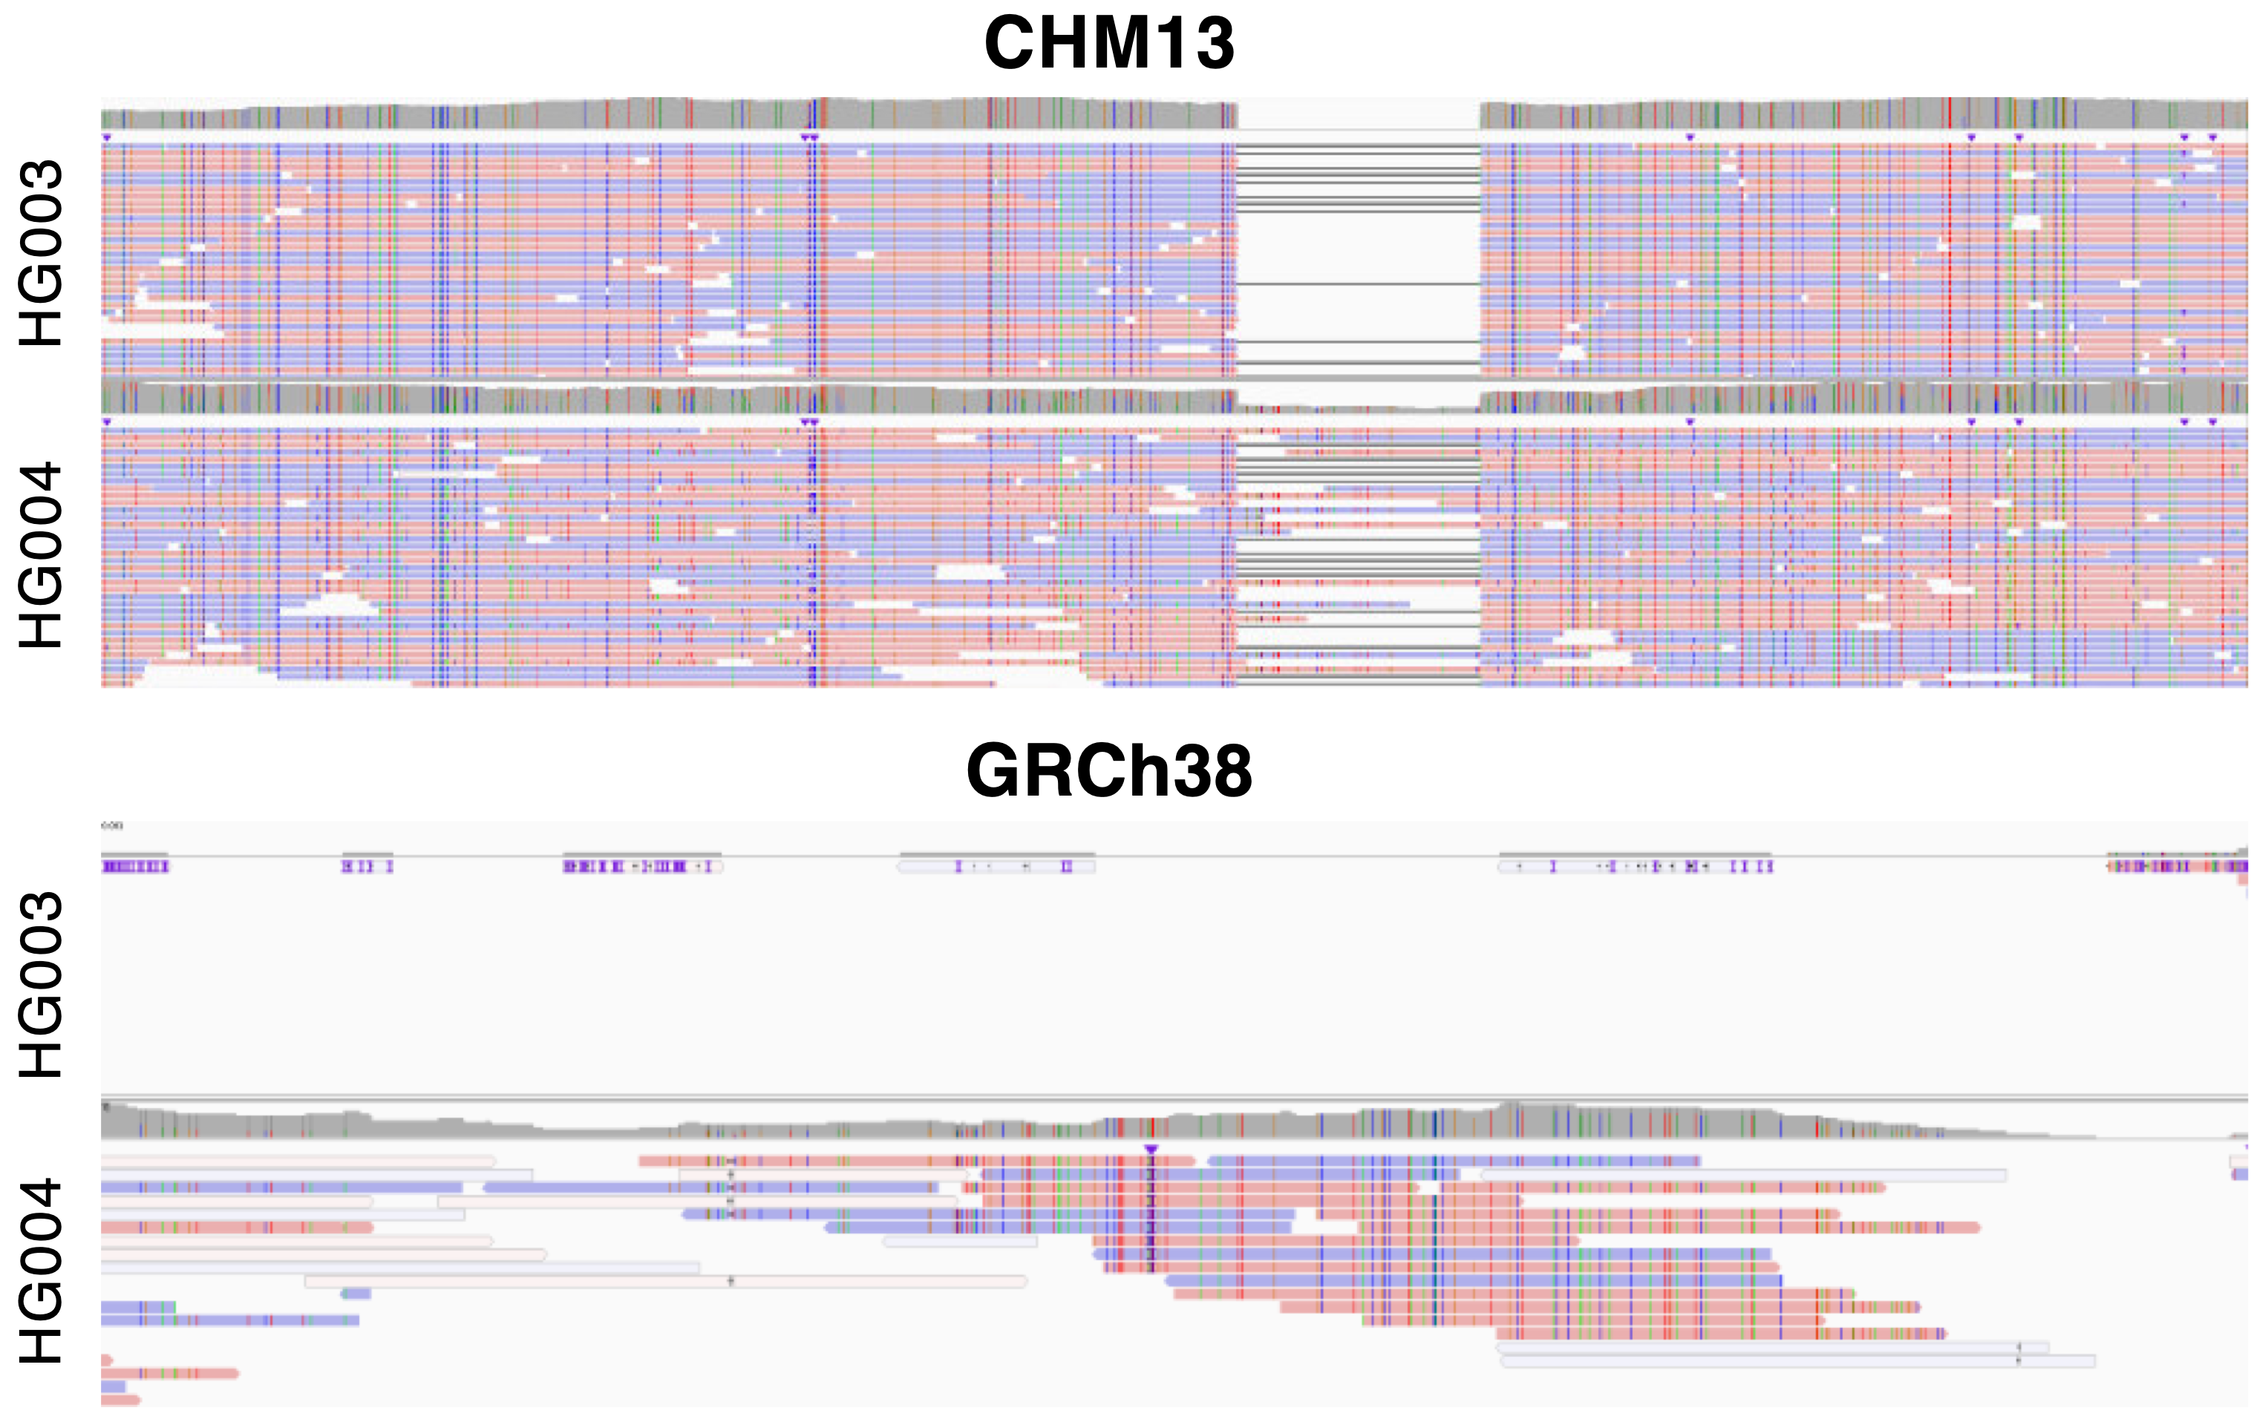
T2T-CHM13 improves resolution of structural variants
GRCh38
Melanie Kirsche
CHM13
Sergey Aganezov
Notes:
we also see that CHM13 allows us to resolve structural variants with better accuracy
this is long-read sequencing data from the same samples, aligned to GRCh38 on the top and CHM13 on the bottom. I hope you can appreciate that it’s much easier to observe and call this structural variant using the CHM13 assembly

Slide 64
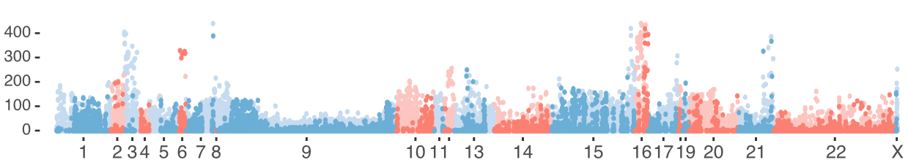
Evolutionary signatures in novel regions of T2T-CHM13
Search for novel variants with strong allele frequency differences between populations
Variants with extreme AF differences are enriched for targets of selection
Chromosome
Cheng et al., 2022, MBE. Detecting selection in multiple populations by modeling ancestral admixture components.
Notes:
so what are these variants doing? We looked for evolutionary signatures on these novel variants
specifically, we looked for novel variants that show strong allele frequency differences between populations
looking at the ones with the most extreme AF differences allows us to enrich for variants that were historically targets of positive selection
this plot shows all of the novel variants, scored by how strong their allele frequency differences are, where we can see that we do observe variants that show this evolutionary signature

Slide 65

Evolutionary signatures in novel regions of T2T-CHM13
Located in a centromeric alpha satellite on chr16
Mexico
Peru
Notes:
if we zoom in on one of these variants and look at the actual allele frequencies, you can see that this one is fairly common in a few populations in the Americas, notably the Peruvian and Mexican populations, and is very rare or complete absent outside of the Americas
this variant is also located in a centromeric alpha satellite on chr16, which is one of those sequences that wasn’t represented in GRCh38
so this is just one example of how, if we have a reference genome that’s complete and contains all of these sequences, we have the potential to uncover potentially interesting biological or evolutionary signatures

Slide 66
T2T-CHM13 improves clinical genomics variant calling
273 challenging, medically relevant genes
Benchmarked with sequencing data from HG002
Daniela Soto
Megan Dennis
Justin Zook
Fritz Sedlazeck
Danny Miller
Notes:
the last thing we did is that we benchmarked the performance of GrCh38 and CHM13 using a set of 273 challenging medically relevant genes, defined by the Genome in a Bottle consortium
we found that for this set of genes, we see a reduction in both false negatives and false positives, across all variant types and sequencing types
this kind of underscores the improvement we can see when using CHM13, especially in challenging regions of the genome

